Slide 1
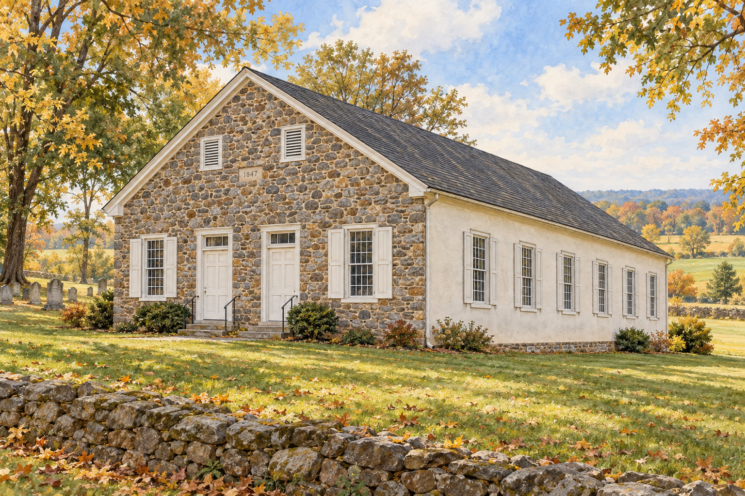
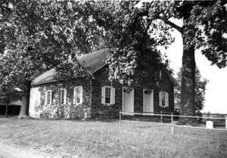
Standing Firm Together
A two-hour training for Church Leadership
Swamp Mennonite Church 1847

Slide 2
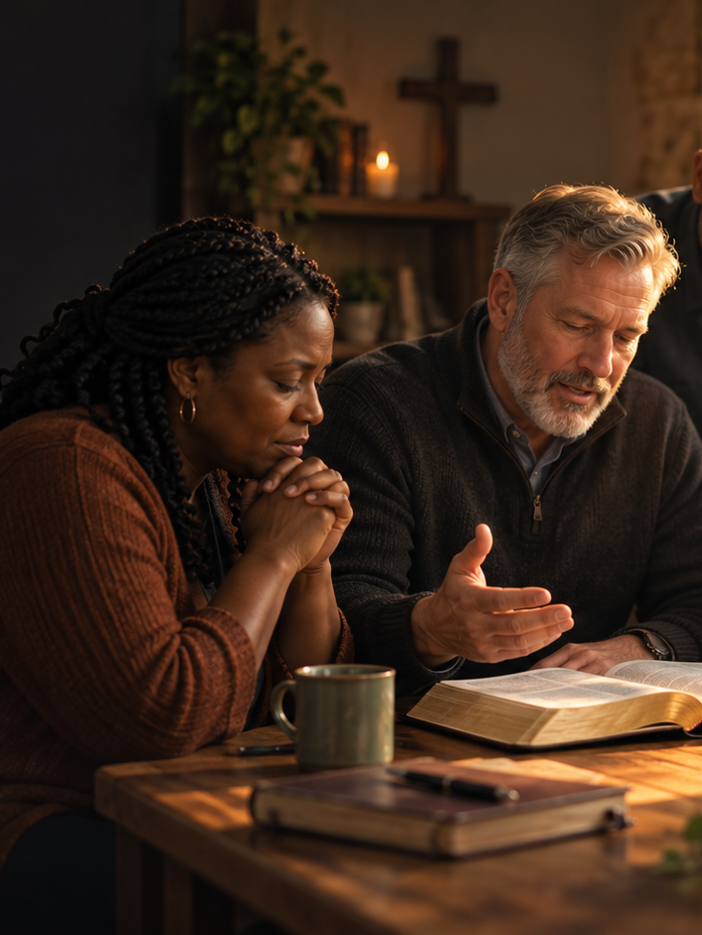
Introduction
Beginning at the Core
Our congregation has already agreed on where the life of faith begins. Among our Points of Agreement we confess that we practice Holy Listening: “In openness to the will of God we listen
to Scripture (God’s settled, written word),
to the Holy Spirit (God’s present, living voice), and
to each other (God’s word tested and confirmed in the body).
in every decision we make. We look for God’s kingdom in all areas of our lives and partner with God in what He is doing.”

Slide 3
Introduction
Beginning at the Core
That sentence is more than a value statement. It describes a way of life — how a Spirit-filled believer walks with God, and how a Spirit-filled community lives together before Him — and it is the reason a church can stand firm when the enemy comes against it.
This training takes that agreed practice and follows it in two directions. It traces Holy Listening
inward, to its source in each believer’s living relationship with the Holy Spirit, and
outward, to our shared life as one body in Christ —
a life that must be guarded, because the very relationships in which we seek God’s kingdom are the ones the evil one most wants to spoil.

Slide 4
Introduction
Beginning at the Core
The path has six steps, and they are given in order for a reason; the order is itself part of the lesson.
Each step rests on the one before it. Begin anywhere but the core, and the later steps become technique without power — the right practices with no life in them.
Attend to the inner life but neglect the guarding, and a listening church is picked off one fiery dart at a time: a word of accusation here, a seed of division there, a wave of fear in a hard season.

Slide 5
Introduction
Beginning at the Core
Our aim as leaders is twofold —
to walk with God ourselves and lead the church family in that same walk for its strengthening, and
to guard that family, and ourselves, from the attacks of the evil one.
Both aims run straight through these six steps.

Slide 6
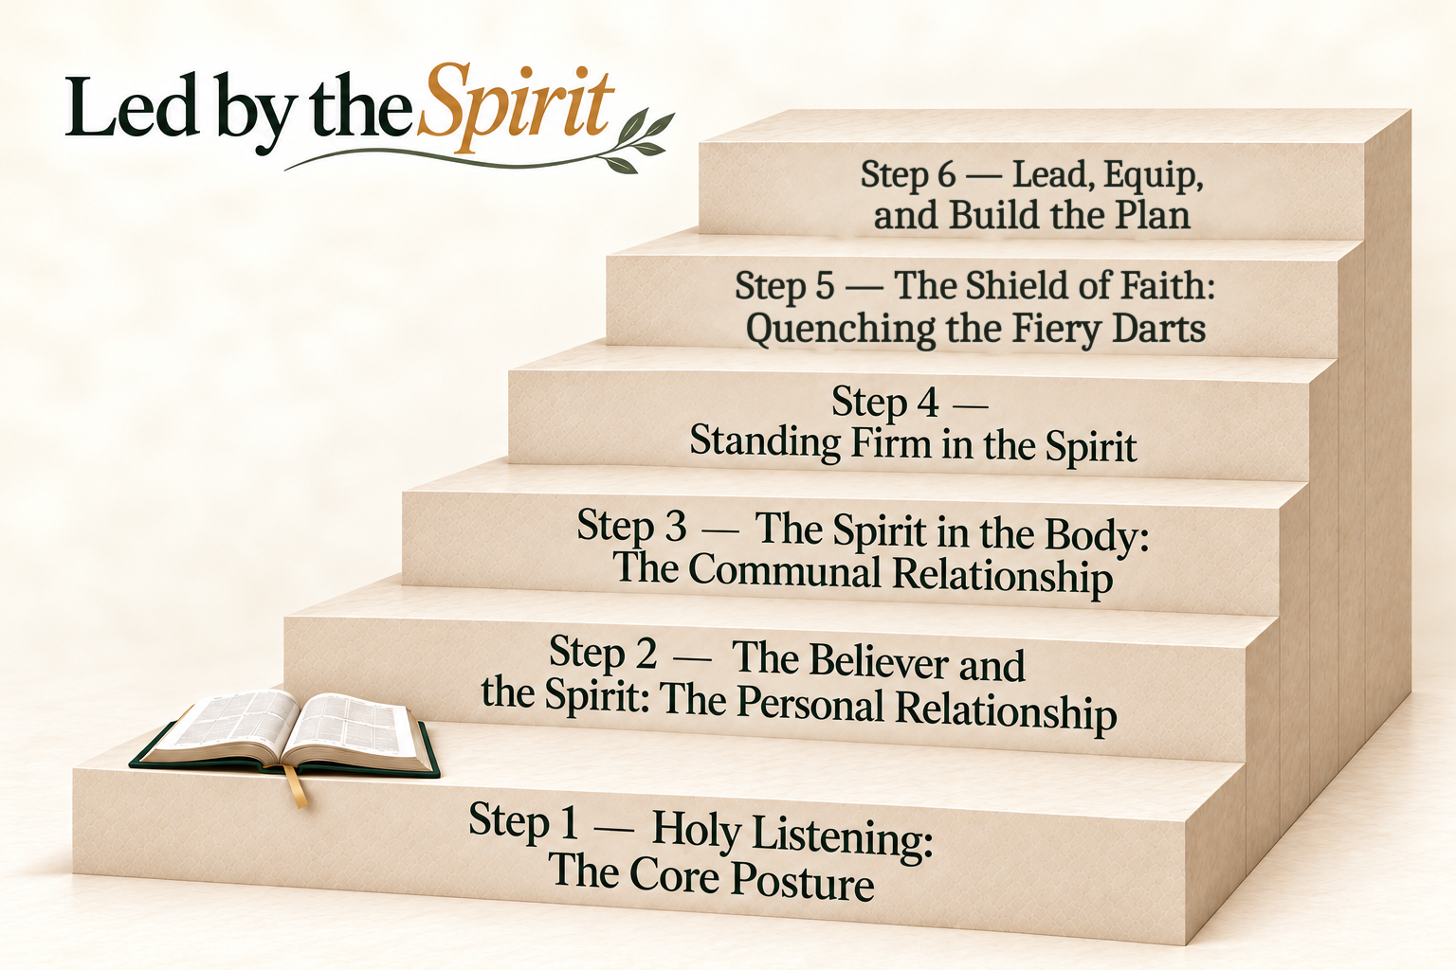

Slide 7
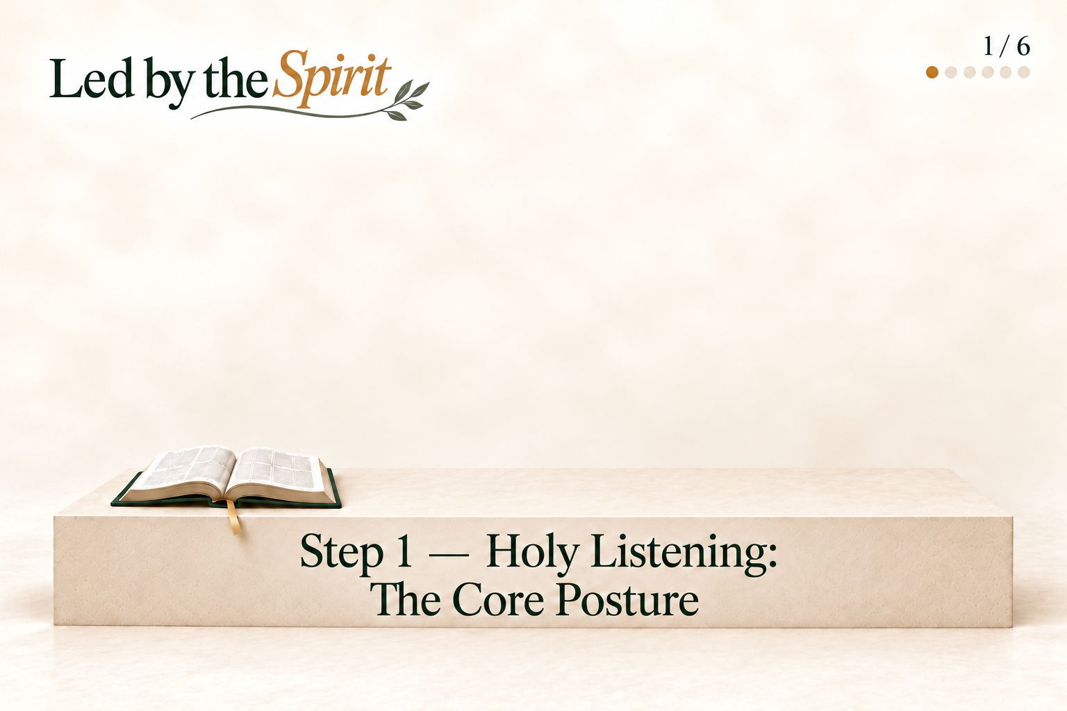

Slide 8

STEP 1
Holy Listening: The Core Posture
Holy Listening is first a posture of the heart, not a technique of the meeting. Before it is anything we do, it is a stance we take: “in openness to the will of God.”
That openness is surrender — a settled willingness to receive God’s will before we know what it will cost. Only from that surrender do the three kinds of listening become possible:
listening to Scripture (God’s settled, written word),
to the Holy Spirit (God’s present, living voice), and
to each other (God’s word tested and confirmed in the body).
Remove the surrender and the listening curdles into its counterfeit — a search for God’s blessing on a life we had already chosen.

Slide 9
STEP 1
Holy Listening: The Core Posture
Key verse:
But He gives more grace. Therefore He says: “God resists the proud, but gives grace to the humble.” Therefore submit to God. Resist the devil and he will flee from you. (James 4:6–7)

Slide 10
STEP 1
Holy Listening: The Core Posture
Why this step is critical: Everything downstream depends on it. A believer or a church that has not first surrendered cannot truly listen; it can only go through the motions.
The posture of Holy Listening is the soil; the other five steps are what grows in it.

Slide 11
HOLY LISTENING: THE CORE POSTURE
Step 1 Questions
Discussion
Analysis
What does genuine openness to God’s will look and sound like in an ordinary week, before we bring Him our own plans?
When has surrender to God changed the direction of your own life, or of this church’s life together?
What practices would help every member of this team come to God and to one another ready to listen rather than to defend?
Where are we most likely to seek God’s blessing on a life we have already chosen, and what would reveal that pattern in us?
How do Scripture, the Holy Spirit, and the gathered body each shape and correct the way we live?
What observable signs would distinguish surrendered waiting on God from avoidance, passivity, or reluctance to obey?
Personal Analysis
What personal preference, fear, or hoped-for outcome may I need to release before I can listen openly for God’s will in my own life?

Slide 12
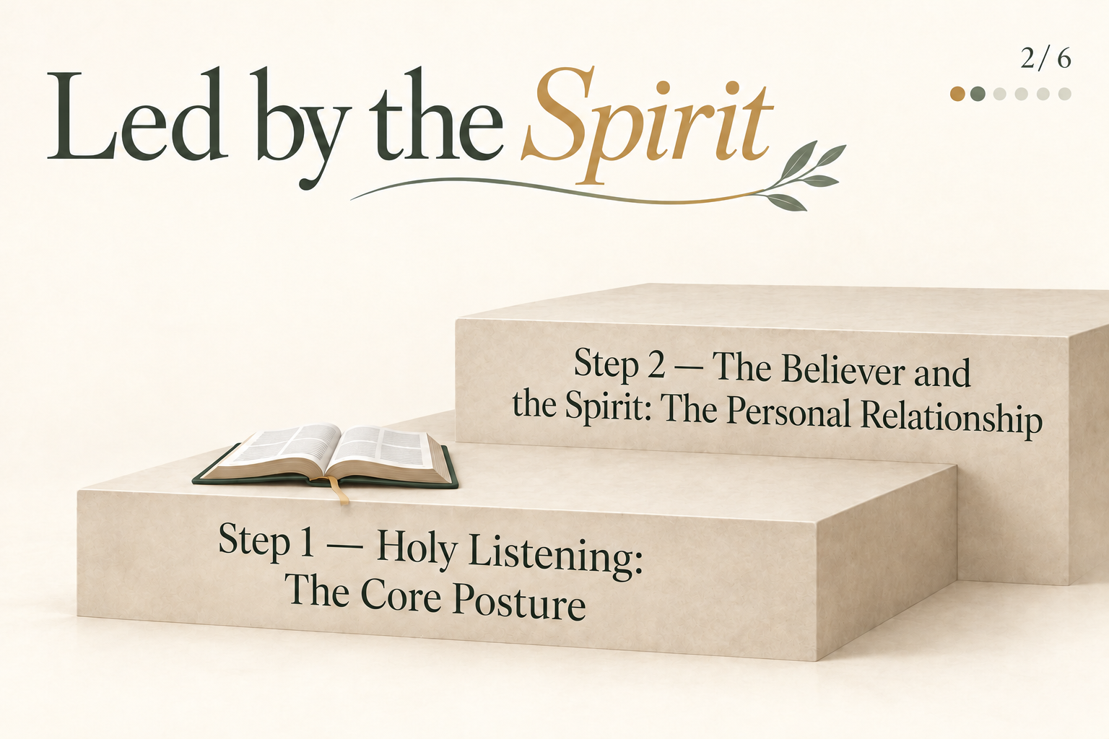

Slide 13
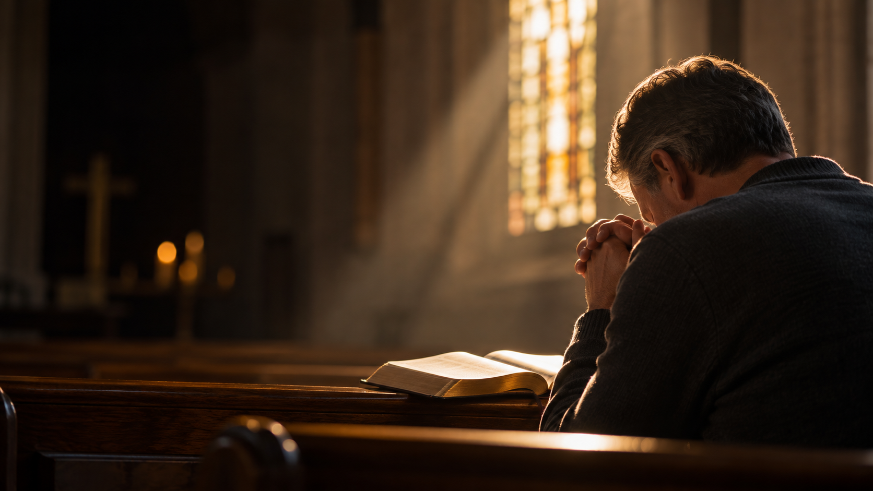
STEP 2
The Believer and the Spirit: The Personal Relationship
We cannot listen to a Person we do not know. Our Covenant of Faith confesses that, “having been baptized by the Holy Spirit into Christ’s Body, we open our lives to the Spirit’s presence and filling for new life and daily guidance in Christian living.”
The Spirit is a person, not a force or an influence — He teaches, guides, convicts, comforts, and can be grieved. His work in the individual believer is the wellspring of everything that follows: He indwells us, fills us, illumines the Scriptures so that we understand them, bears His fruit in us, and gives the daily guidance that Holy Listening depends on.

Slide 14
STEP 2
The Believer and the Spirit: The Personal Relationship
Key verse:
However, when He, the Spirit of truth, has come, He will guide you into all truth; for He will not speak on His own authority, but whatever He hears He will speak; and He will tell you things to come. (John 16:13)

Slide 15
STEP 2
The Believer and the Spirit: The Personal Relationship
This is why our personal devotion — Scripture, prayer, obedience — is not separate from the church’s life together but its lifeblood.
Our private walk with the Spirit on Monday is what each of us brings to the gathered body on Sunday.

Slide 16
STEP 2
The Believer and the Spirit: The Personal Relationship
Why this step is critical: Only a Spirit-filled believer can truly listen. A life lived “in the flesh” and a life lived “in the Spirit” can look identical on the surface and be worlds apart in their source. The difference begins here.

Slide 17
THE BELIEVER AND THE SPIRIT: THE PERSONAL RELATIONSHIP
Step 2 Questions
Discussion
Analysis
How do our personal habits of Scripture, prayer, and obedience shape what each of us brings to our life together?
How would we explain the difference between the Spirit’s guidance and a strong personal impression, emotion, or preference?
How can this team encourage one another to remain spiritually attentive between Sundays rather than treating the spiritual life as a meeting-only activity?
What evidence would suggest that our walk with the Spirit is healthy, and what evidence would suggest that we need to slow down and return to Him?
How could fatigue, unresolved conflict, unconfessed sin, or spiritual dryness quietly weaken our walk with God and one another without our recognizing it?
Which shared spiritual practices should we adopt during the coming months so that our life together grows from communion with God?
Personal Analysis
Where is the Spirit asking me for renewed obedience, deeper prayer, or greater attentiveness in my daily walk?

Slide 18
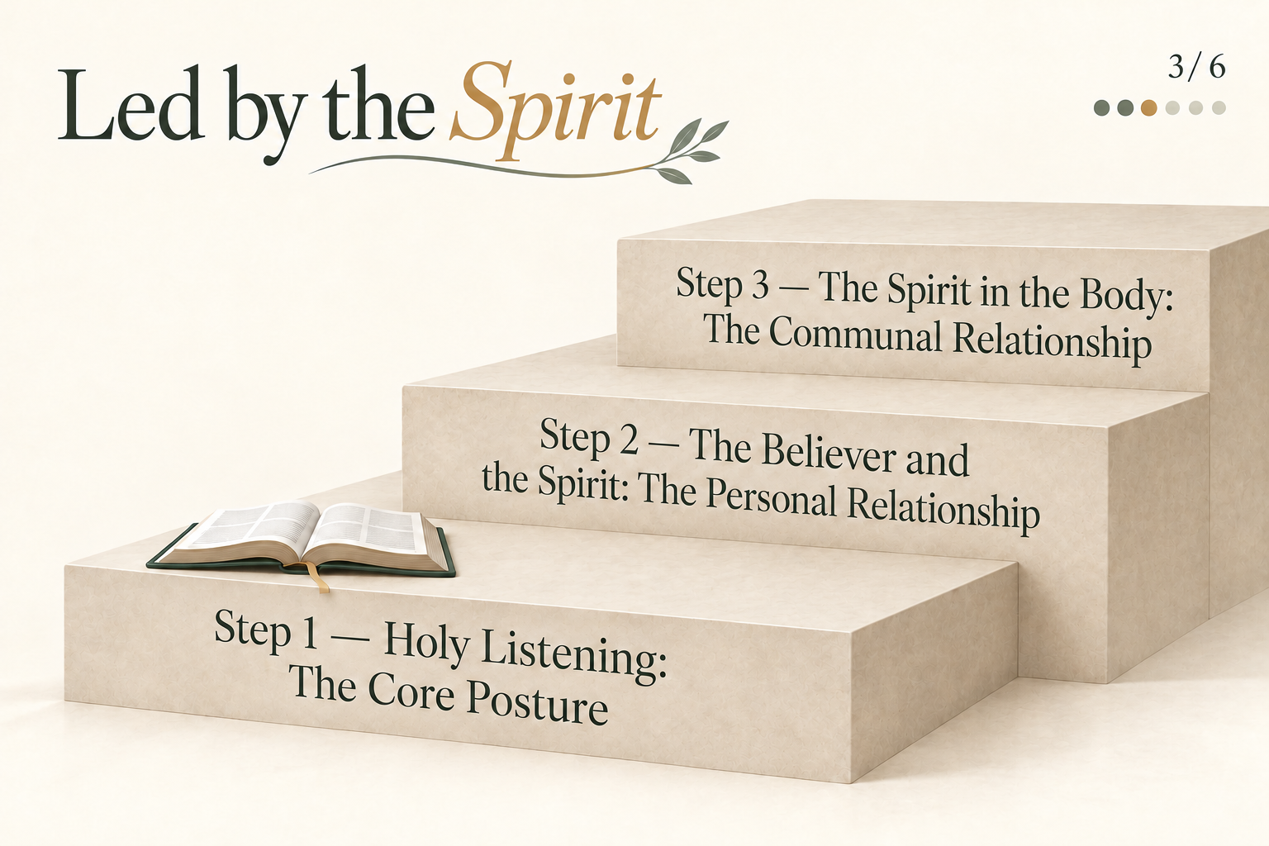

Slide 19
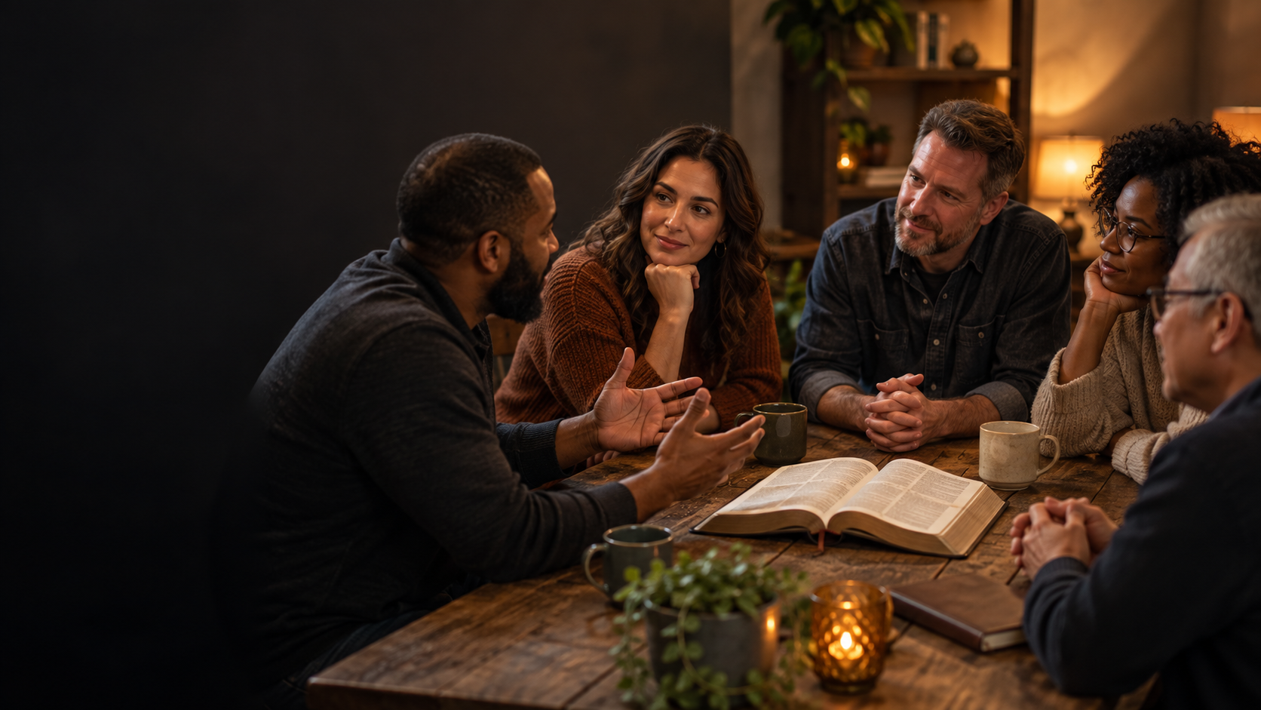
STEP 3
The Spirit in the Body: The Communal Relationship
The same Spirit who fills the individual is given to the whole body, and He distributes His gifts among all the members. This is why Holy Listening includes listening “to each other.” The Christian life is a “we,” not only an “I.”
Our Covenant commits us to “submit ourselves to one another as members of Christ’s Body, the Church, for mutual upbuilding around His Word and Spirit.” No single believer holds the whole picture; the Spirit often speaks to the gathered body what He will not entrust to one person alone.

Slide 20
STEP 3
The Spirit in the Body: The Communal Relationship
Key verse:
But the manifestation of the Spirit is given to each one for the profit of all. (1 Corinthians 12:7)

Slide 21
STEP 3
The Spirit in the Body: The Communal Relationship
The same Spirit who fills the individual is given to the whole body, and He distributes His gifts among all the members. This is why Holy Listening includes listening “to each other.”
The Christian life is a “we”, not only an “I”. Our Covenant commits us to “submit ourselves to one another as members of Christ’s Body, the Church, for mutual upbuilding around His Word and Spirit.”
Where each member insists on their own certainty, the body cannot hear; where members submit to one another in love, the Spirit’s word through the whole becomes audible.
Mutual submission is what makes our life together safe. Where each member insists on their own certainty, the body cannot hear; where members submit to one another in love, the Spirit’s word through the whole becomes audible.

Slide 22
STEP 3
The Spirit in the Body: The Communal Relationship
Why this step is critical: A church that skips this step reduces its common life to the opinion of the strongest voice. The communal relationship is the God-designed safeguard against both individualism and manipulation.

Slide 23
THE SPIRIT IN THE BODY: THE COMMUNAL RELATIONSHIP
Step 3 Questions
Discussion
Analysis
Whose voices, gifts, experiences, and perspectives are presently heard in our life together, and whose may be missing?
When have differences in age, ministry experience, background, or spiritual gifting helped us see something more clearly together?
What makes disagreement safe enough that a minority concern can be heard without becoming either controlling or ignored?
Which patterns in our life together unintentionally amplify the strongest, quickest, or most confident voices?
How can we listen well to the whole congregation and draw out the gifts the Spirit has given to every member?
What commitments of mutual submission will we need when another person’s insight challenges our own assumptions?
Personal Analysis
How do I normally respond when another person’s insight contradicts mine, and what would mutual submission require of me?

Slide 24
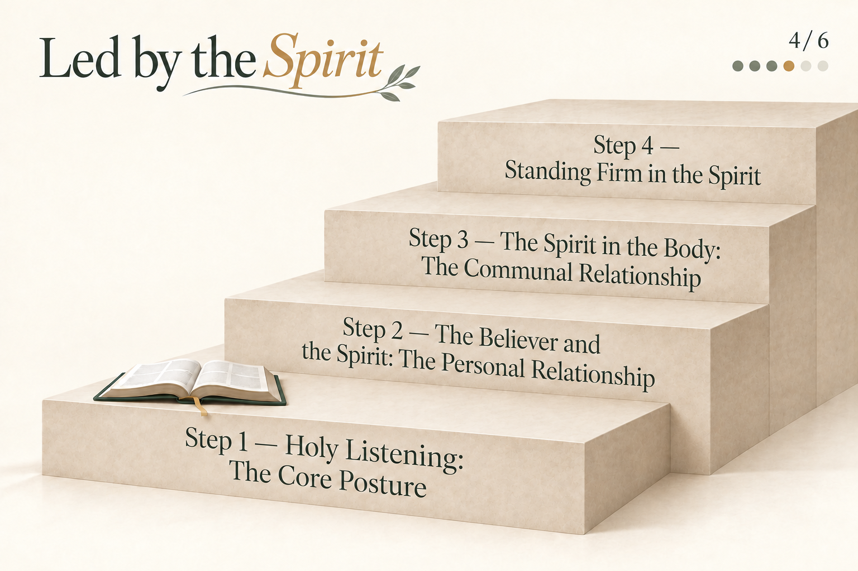

Slide 25

STEP 4
Standing Firm in the Spirit
Out of this relationship — personal and communal — comes the power to stand. Paul’s charge opens the armor passage: “be strong in the Lord and in the power of His might.” The verb is passive: we are strengthened; we do not strengthen ourselves.
Standing firm is not gritted-teeth determination but a Spirit-given stability, a settled ground beneath our feet that holds when pressure comes.
The word for this stance runs through the passage — στῆναι (G2476, “to stand, to hold one’s ground”). It is the posture of a soldier who has taken his position and will not be moved.

Slide 26
STEP 4
Standing Firm in the Spirit
Key verse:
Finally, my brethren, be strong in the Lord and in the power of His might. Put on the whole armor of God, that you may be able to stand against the wiles of the devil. (Ephesians 6:10–11)

Slide 27
STEP 4
Standing Firm in the Spirit
For a leadership team, this is the difference between reacting and standing.
A church in a hard season will be pushed — by urgency, by strong feelings, by grief and loss, by the fear of decline. Standing firm is the Spirit-wrought steadiness that lets the body keep listening to God and loving one another without panic.

Slide 28
STEP 4
Standing Firm in the Spirit
Why this step is critical: A life lived from anxious, unstable ground bends toward whatever relieves the pressure fastest. Only those who stand can truly listen.

Slide 29
STANDING FIRM IN THE SPIRIT
Step 4 Questions
Discussion
Analysis
What pressures—time, finances, attendance, conflict, cultural change, grief, or fear of decline—are most likely to unsettle our walk with God and with one another?
What would standing firm look like when spiritual growth is slow or when we face honest disagreement?
Can we name a season in which pressure drove us closer to God, or instead pushed us toward fear and self-reliance?
How will we distinguish faithful patience from avoidance, and steady faith from anxiety-driven haste?
Which truths about God, the church, and our calling can provide stable ground when we feel pressure to produce quick results?
What habits of prayer, Sabbath rest, and mutual care would keep pressure, strong personalities, or outside expectations from unsettling us?
Personal Analysis
When pressure rises, am I most tempted to rush, control, withdraw, or seek quick agreement, and how is God calling me to stand instead?

Slide 30
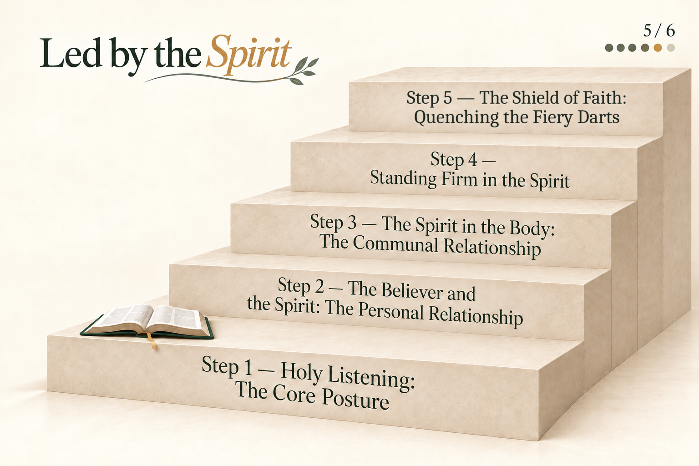

Slide 31

STEP 5
The Shield of Faith: Quenching the Fiery Darts
A listening church is a church under fire. Paul knew it, and so he gives the one piece of armor that covers all the rest: “above all, taking the shield of faith.”
The shield he names is the θυρεός (G2375) — not a small round buckler but the great door-shaped shield, as tall as a man, that covered the whole body and could be locked edge-to-edge with the shields of others to form a moving wall.
Faith itself is that shield. To “take it up” — ἀναλαμβάνω (G353) — is a deliberate act of the will: faith is raised, not merely felt.

Slide 32
STEP 5
The Shield of Faith: Quenching the Fiery Darts
The enemy’s weapons are “the fiery darts of the wicked one” — βέλη (G956) that burned as they struck. Against a listening church he aims a predictable set: accusation, doubt, fear, division, discouragement, and haste.
Faith quenches them — σβέσαι (G4570, “to extinguish, put out”) — not by arguing with each dart but by resting the whole weight of the soul on what is true about God: His character, His promises, and the finished work of Christ.

Slide 33
STEP 5
The Shield of Faith: Quenching the Fiery Darts
The dart of fear is quenched by the truth that God is sovereign and good.
The dart of division, by the truth that we are one body in one Spirit.
The dart of accusation, by the truth that there is no condemnation for those who are in Christ.

Slide 34
STEP 5
The Shield of Faith: Quenching the Fiery Darts
Key verse:
above all, taking the shield of faith with which you will be able to quench all the fiery darts of the wicked one. (Ephesians 6:16)

Slide 35
STEP 5
The Shield of Faith: Quenching the Fiery Darts
And because the shield was made to lock with others, a leadership team does not each hold a small shield alone.
They raise one shield together over the whole church family — covenanting to trust God, and one another, when the darts fly.

Slide 36
STEP 5
The Shield of Faith: Quenching the Fiery Darts
Why this step is critical: Without the shield, every previous step is exposed. A church can listen, stand, and grow together, and still be undone by a single well-aimed dart of fear or division. The shield is what guards our life together to the end.

Slide 37
THE SHIELD OF FAITH: QUENCHING THE FIERY DARTS
Step 5 Questions
Discussion
Analysis
Which fiery darts—fear, accusation, division, discouragement, doubt, or haste—are most likely to strike our walk with God and our relationships with one another?
How should this team respond when criticism, misunderstanding, or mistrust begins to affect relationships?
What specific truths about God and our life together should we raise as a shared shield during the coming months?
What safeguards could help us recognize and address division, fear, or accusation before it takes root among us?
How can we speak with the congregation about the spiritual battle in ways that build trust and faith rather than fear?
What behaviors would demonstrate that the team is raising one shield together rather than protecting individual positions?
Personal Analysis
Which fiery dart is most likely to weaken my walk with God or my love for others, and what truth about God must I deliberately trust when it comes?

Slide 38
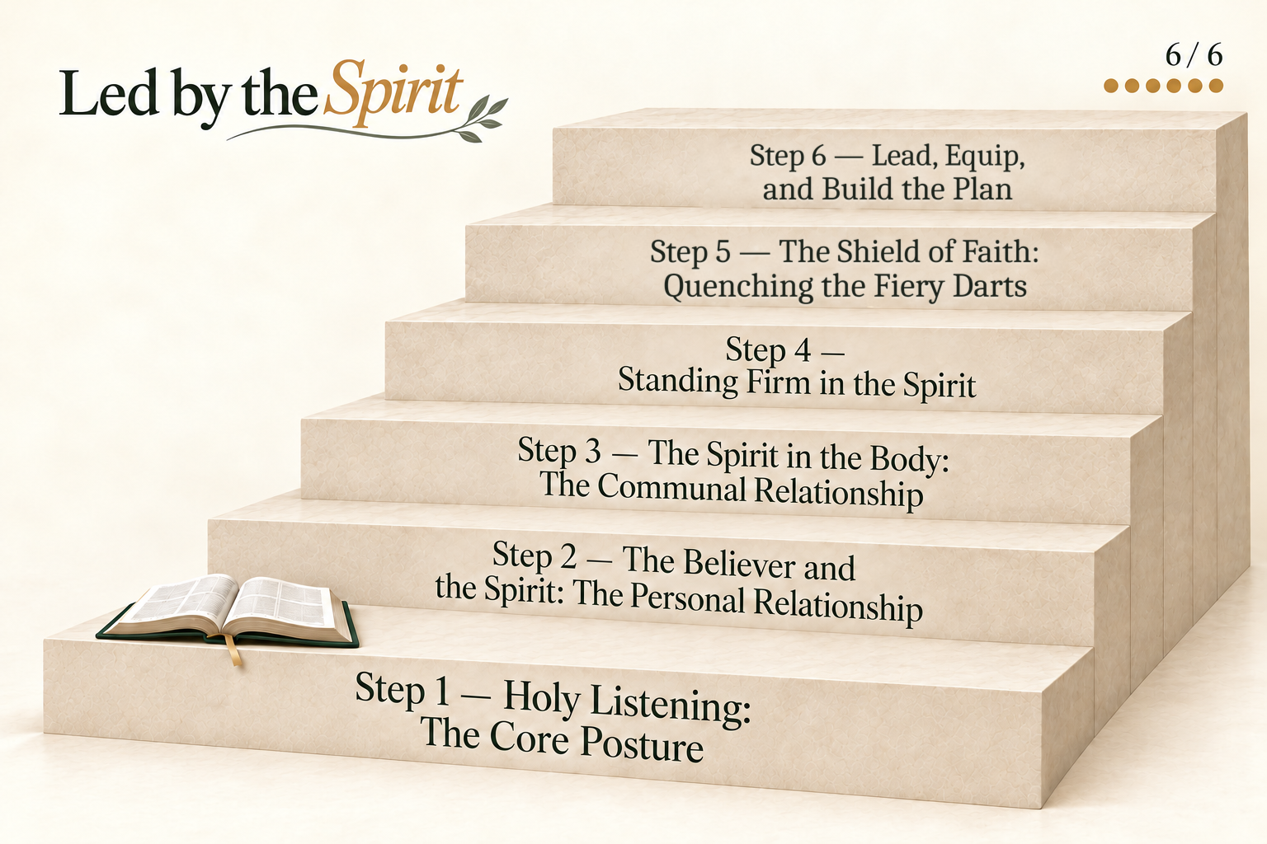

Slide 39
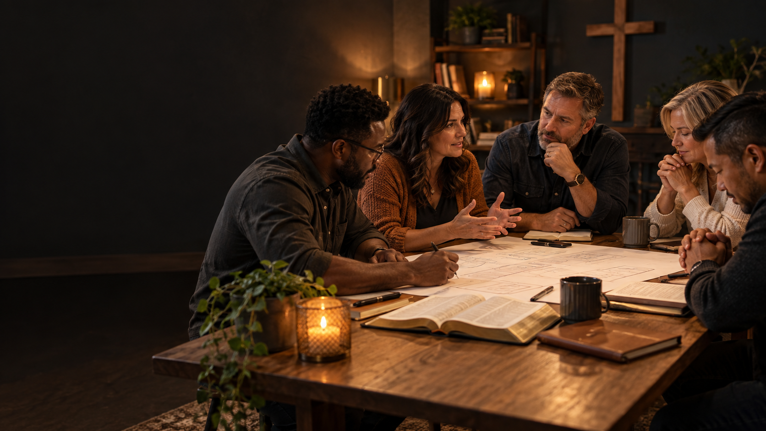
STEP 6
Lead, Equip, and Build the Plan
The first five steps now turn outward into the leadership task.
To lead is to walk ahead of the church family on this same pathway in everyday life — living in surrender, listening to Scripture and Spirit and one another, standing firm, and raising the shield together.
To equip is to teach every member to walk the steps themselves, so that Holy Listening becomes the whole body’s habit and not only the leaders’. Both together strengthen the family and guard it from the evil one.

Slide 40
STEP 6
Lead, Equip, and Build the Plan
Key verse:
And He Himself gave some to be apostles, some prophets, some evangelists, and some pastors and teachers, for the equipping of the saints for the work of ministry, for the edifying of the body of Christ, till we all come to the unity of the faith and of the knowledge of the Son of God, to a perfect man, to the measure of the stature of the fullness of Christ. (Ephesians 4:11–13)

Slide 41
STEP 6
Lead, Equip, and Build the Plan
The final movement of this training is to evaluate our personal relationship to the Spirit and how we have made these steps the settled practice of our lives personally, and how we are to lead the church family into a growing relationship with the Spirit of God.

Slide 42
STEP 6
Lead, Equip, and Build the Plan
Why this step is critical: A pathway that stays in the leaders’ notebooks changes nothing. The plan is where Holy Listening and guarding become the lived habit of the whole family.

Slide 43
LEAD, EQUIP, AND BUILD THE PLAN
Step 6 Questions
Discussion
Analysis
If the goal today is to begin rather than finish the plan, what meaningful ways are we committed to implementing the commands of God in our lives?
What initial commitments would help us continue—biblical anchors, personal practices, shared practices, assignments, or a common prayer?
How and when should the wider congregation be invited to pray, learn, and walk this pathway with us?
What sequence of teaching, practice, encouragement, and review should guide our life together over the coming year?
Which roles, resources, and voices are needed to help the whole congregation walk these steps, and who will carry each one?
What review points will keep us accountable to Holy Listening and allow the plan to grow as we grow?
Personal Analysis
What concrete responsibility am I willing to accept, and how will I carry it in a spirit of humility, prayer, and mutual submission?

Slide 44
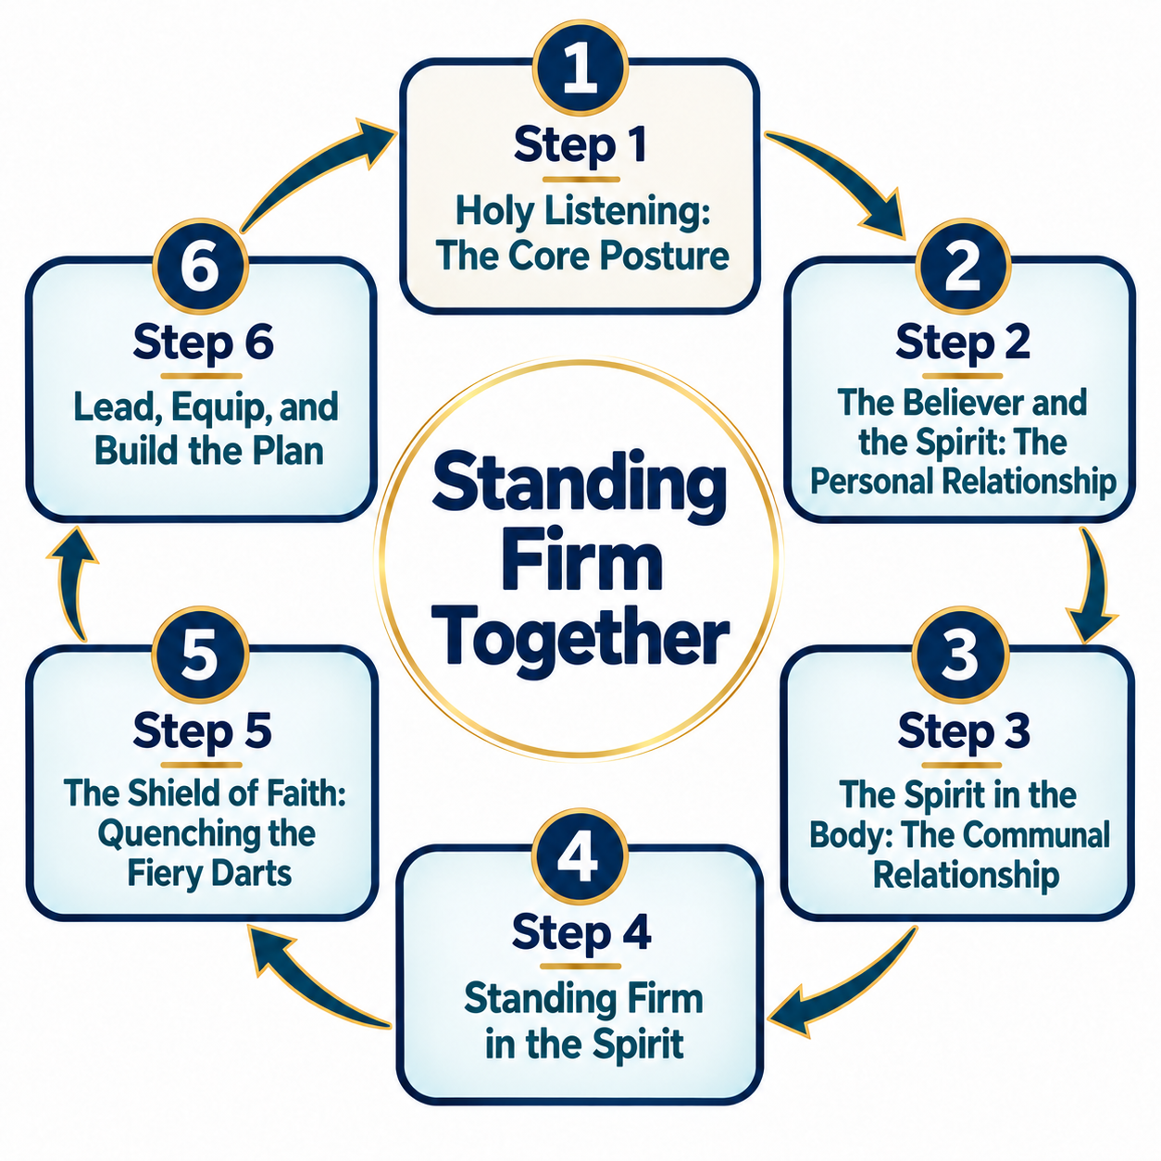
WHOLE PATHWAY REVIEW
Summary Review

Slide 45
WHOLE PATHWAY REVIEW
Discussion Questions
Use these whole-pathway questions after the initial training or in later meetings. They help the team revisit the relationships among the six steps as our life together grows.
Holy Listening names three voices — Scripture, the Spirit, and one another. In our daily lives and in our life together, which of the three gets the most attention, and which the least? What happens when one is missing?
Step 2 says only a Spirit-filled believer can truly listen. In plain terms, how would you describe the difference between a life lived “in the flesh” and one lived “in the Spirit”?
The Christian life is a “we,” not only an “I.” Where have you seen this body receive together something from God that no one person saw alone?
Of the fiery darts named here — accusation, doubt, fear, division, discouragement, haste — which have you seen aimed at this church, or its leaders, in a hard season?
If Holy Listening is truly the core, what would change in our daily walk and in our life together if we began there every single day?

Slide 46
WHOLE PATHWAY REVIEW
Analysis Questions
Trace the order of the six steps. Why must the relationship with the Spirit (steps 2 and 3) come before standing and the shield (steps 4 and 5)? What specifically breaks if a church tries to stand without that foundation?

Slide 47
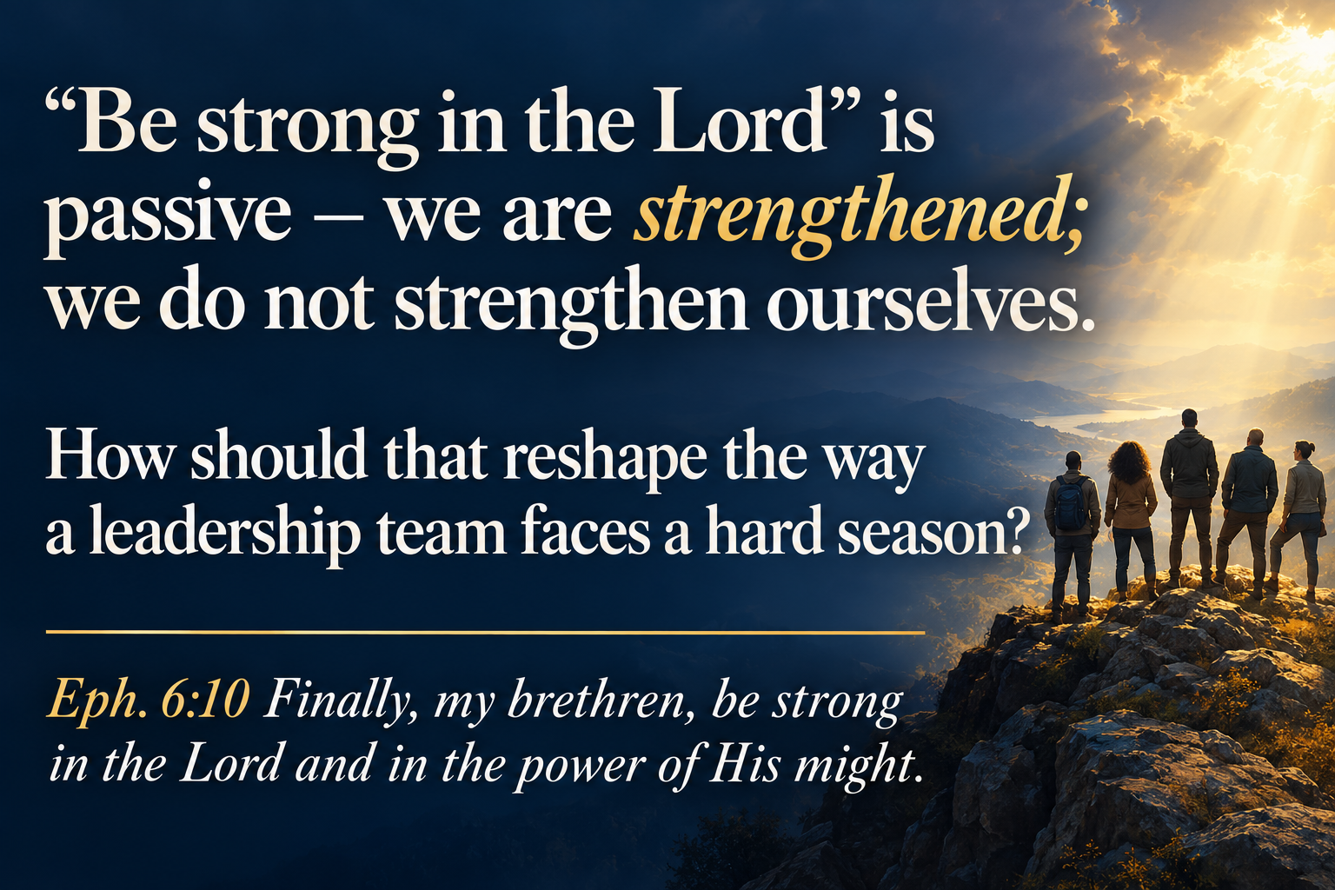
WHOLE PATHWAY REVIEW
Analysis Questions
“Be strong in the Lord” is passive — we are strengthened; we do not strengthen ourselves. How should that reshape the way a leadership team faces a hard season?
Eph. 6:10 Finally, my brethren, be strong in the Lord and in the power of His might.

Slide 48
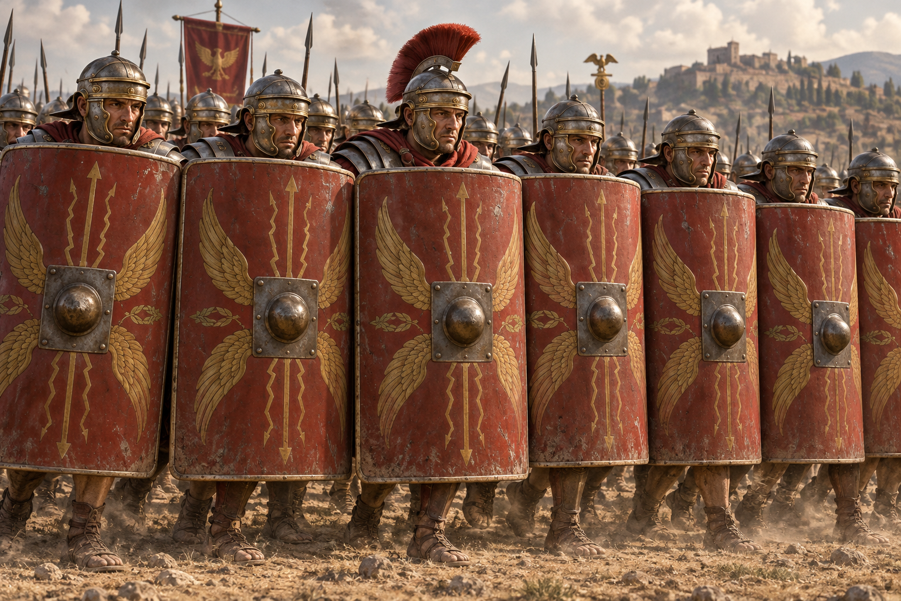
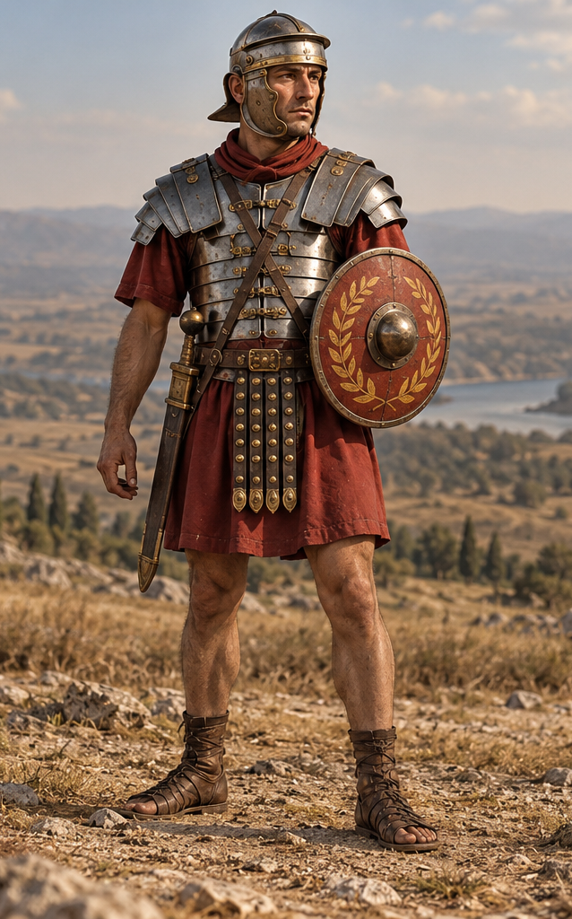
WHOLE PATHWAY REVIEW
Analysis Questions
The θυρεός was the great shield that covered the whole body and locked with others into a wall. What does that picture demand of a leadership team raising the shield of faith together, as opposed to each leader holding a small shield alone?

Slide 49
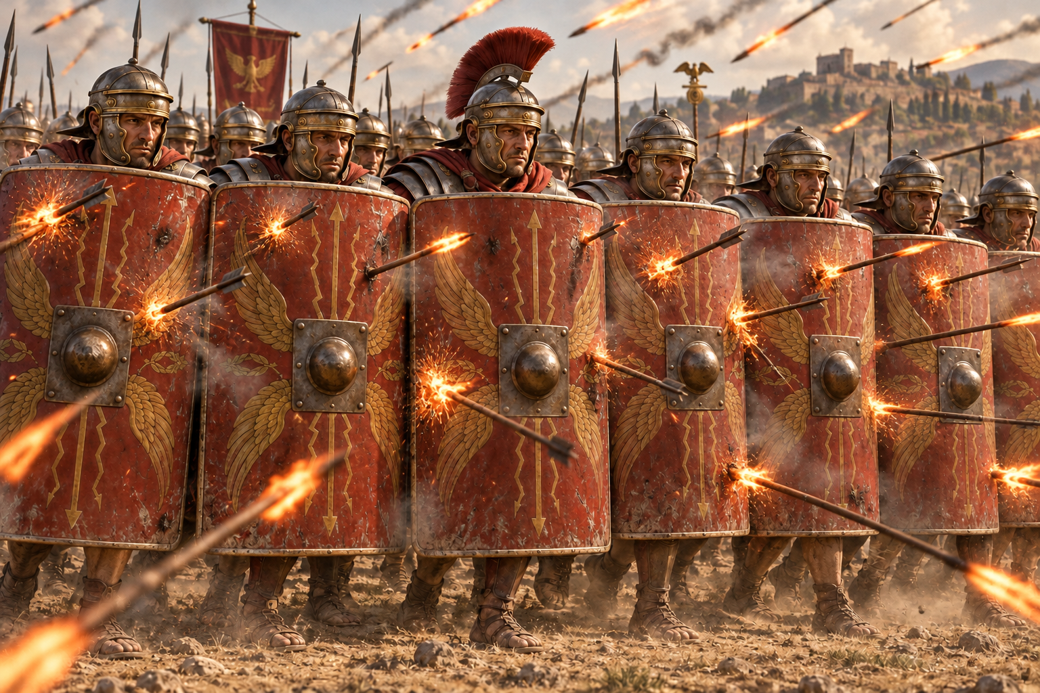
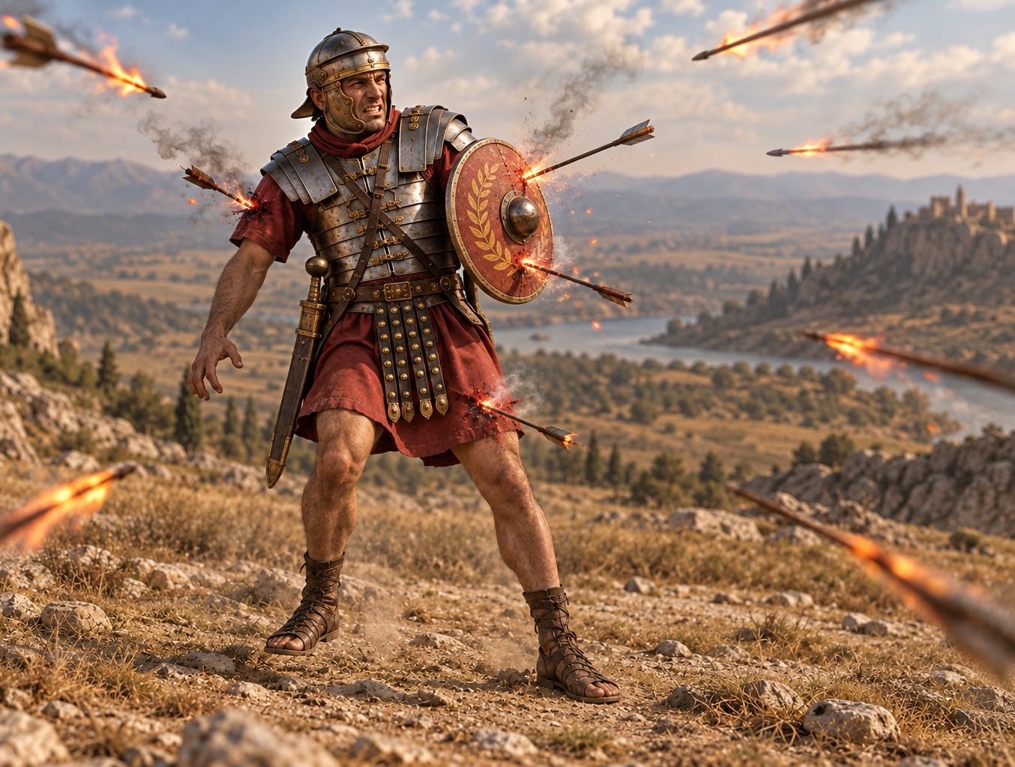
WHOLE PATHWAY REVIEW
Analysis Questions
Faith quenches the darts. Take one dart — say, fear or division — and name the specific truth about God’s character or promises that a leader would raise as the shield against it.

Slide 50

WHOLE PATHWAY REVIEW
Analysis Questions
Distinguish genuine life in the Spirit from counterfeits: busyness in ministry, outward conformity to church custom. How would you tell them apart in your own life?

Slide 51
WHOLE PATHWAY REVIEW
Personal Evaluation
Honestly, where am I in these six steps right now — and which single step is God asking me to attend to first in my own walk, before I try to lead others through it?

