Slide 1
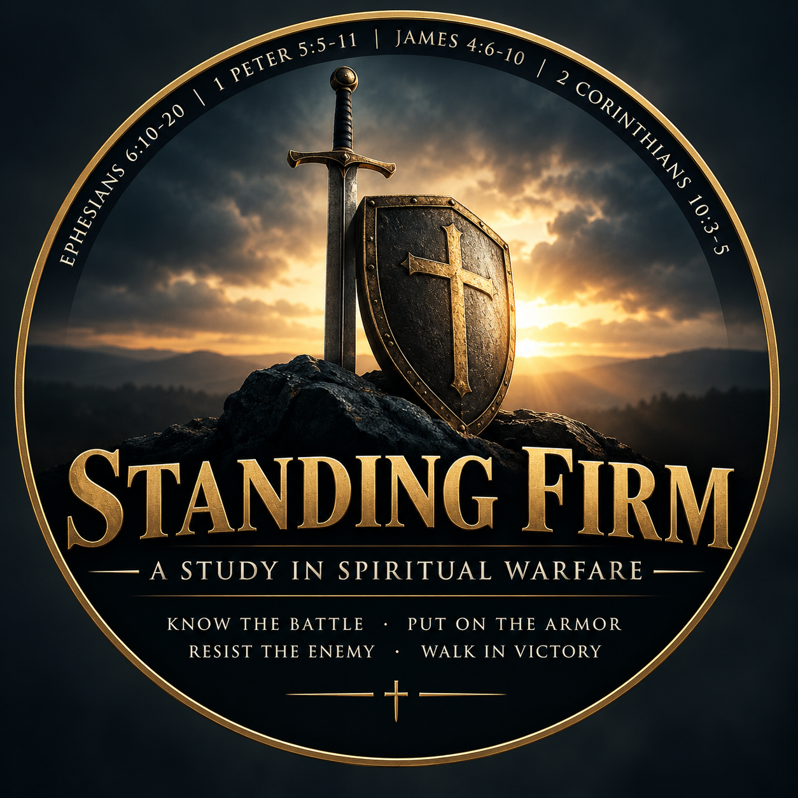
Class 1
Ephesians 6:10–13
The Call to Stand
Adult Bible Study
Be strong · Put on · Stand

Slide 2
Purpose of This Lesson
An in-depth exegetical companion to the Week 1 teaching and student notes.
Written for lay members who want to look more closely at the Greek text itself.
Focuses on what believers are actually commanded to do in spiritual battle.
Shows how armor language connects to putting on Christ and Christian character.
Introduction

Slide 3
Two Focal Points
ἵστημι and ἀνθίστημι — “stand” and “withstand.”
Their repeated use shows the kind of action a believer is called to take.
ἐνδύω — “put on.”
This verb is traced through Paul’s letters: Christ, the new man, virtues, and armor.
Introduction

Slide 4
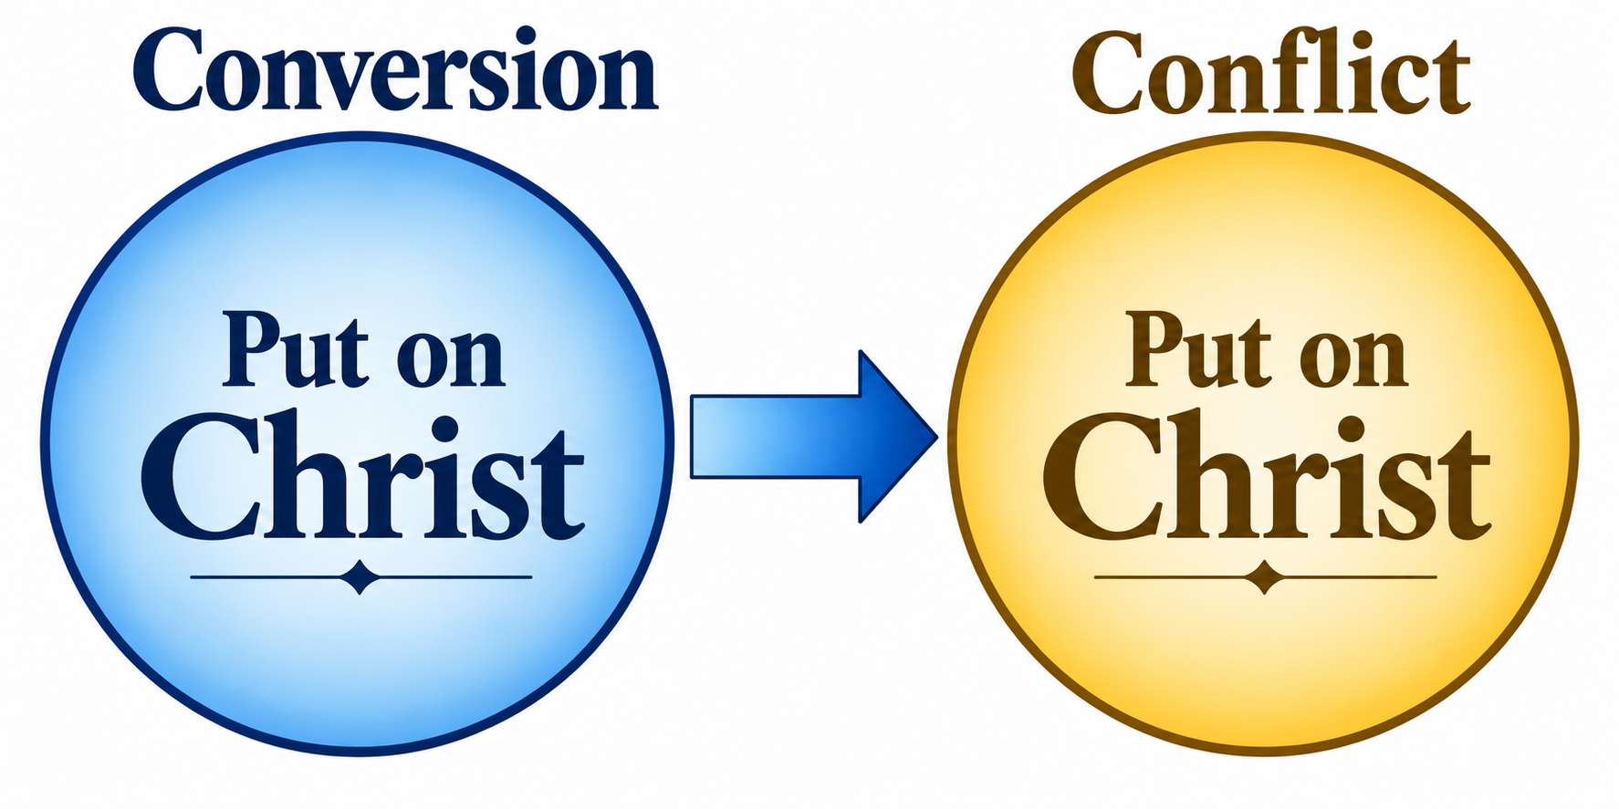
The Governing Insight
The armor of God is not separate equipment issued to a soldier; it is the believer’s Christ-formed character, deployed for conflict.
Spiritual warfare is not detached from ordinary Christian growth.
The same Christ we put on at conversion is the life we deliberately wear in the day of conflict.
Introduction

Slide 5
Positional Reality and Experiential Response
What God has done
What the believer does
Forgiven
Sealed
Indwelt by the Spirit
Blessed in Christ
Equipped by God
Be strong
Put on the armor
Stand firm
Withstand pressure
Resist by faith
The armor is God’s provision, appropriated by faith.
Framework

Slide 6
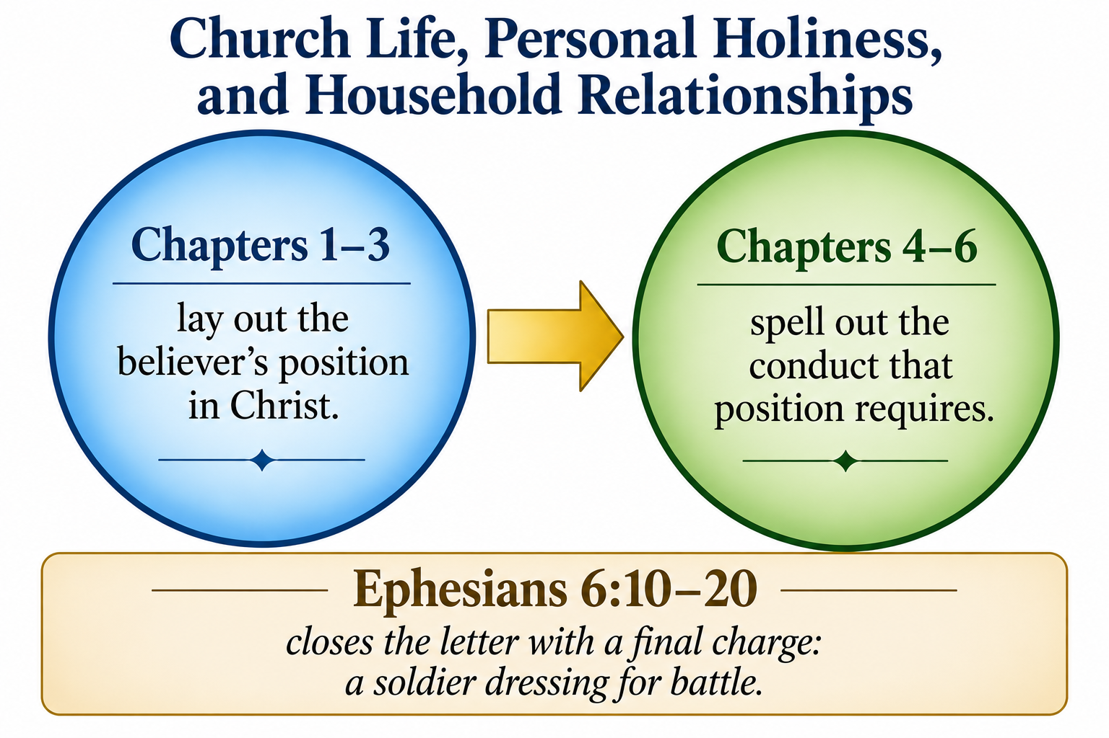
Ephesians: Doctrine to Duty
Chapters 1–3 lay out the believer’s position in Christ.
Chapters 4–6 spell out the conduct that position requires.
The letter moves through church life, personal holiness, and household relationships.
Ephesians 6:10–20 closes the letter with a final charge: a soldier dressing for battle.
Overview

Slide 7
The Flow of Ephesians 6:10–13
1
2
3
4
5
6
Be strong
in the Lord
Put on
the armor
Stand against
the schemes
Know the real
opponent
Take up
the armor
Withstand
and stand
The passage circles the same three commands — be strong, put on, stand — building intensity through repetition rather than progression.
Overview

Slide 8
Opening Questions
When you hear the phrase “spiritual warfare,” what image or story comes to mind first?
Have you ever felt you were up against something larger than an ordinary human problem?
What assumptions do we bring before Paul has a chance to define the battle?
Opening Questions

Slide 9
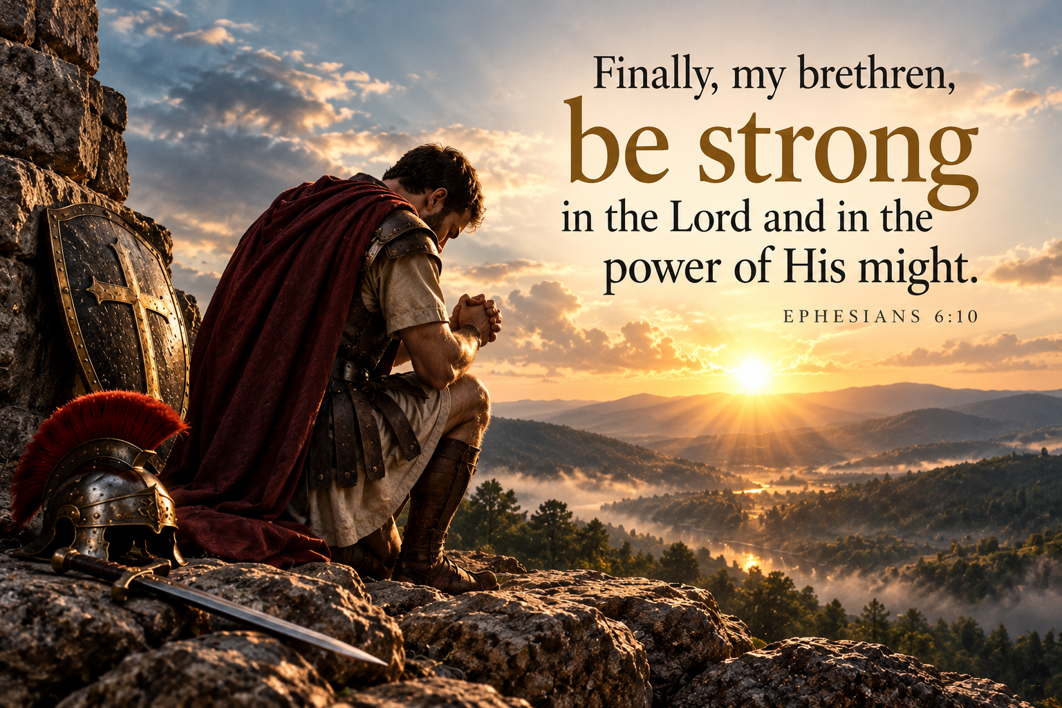
The Text: Ephesians 6:10
“Finally, my brethren, be strong in the Lord and in the power of His might."
The Text

Slide 10
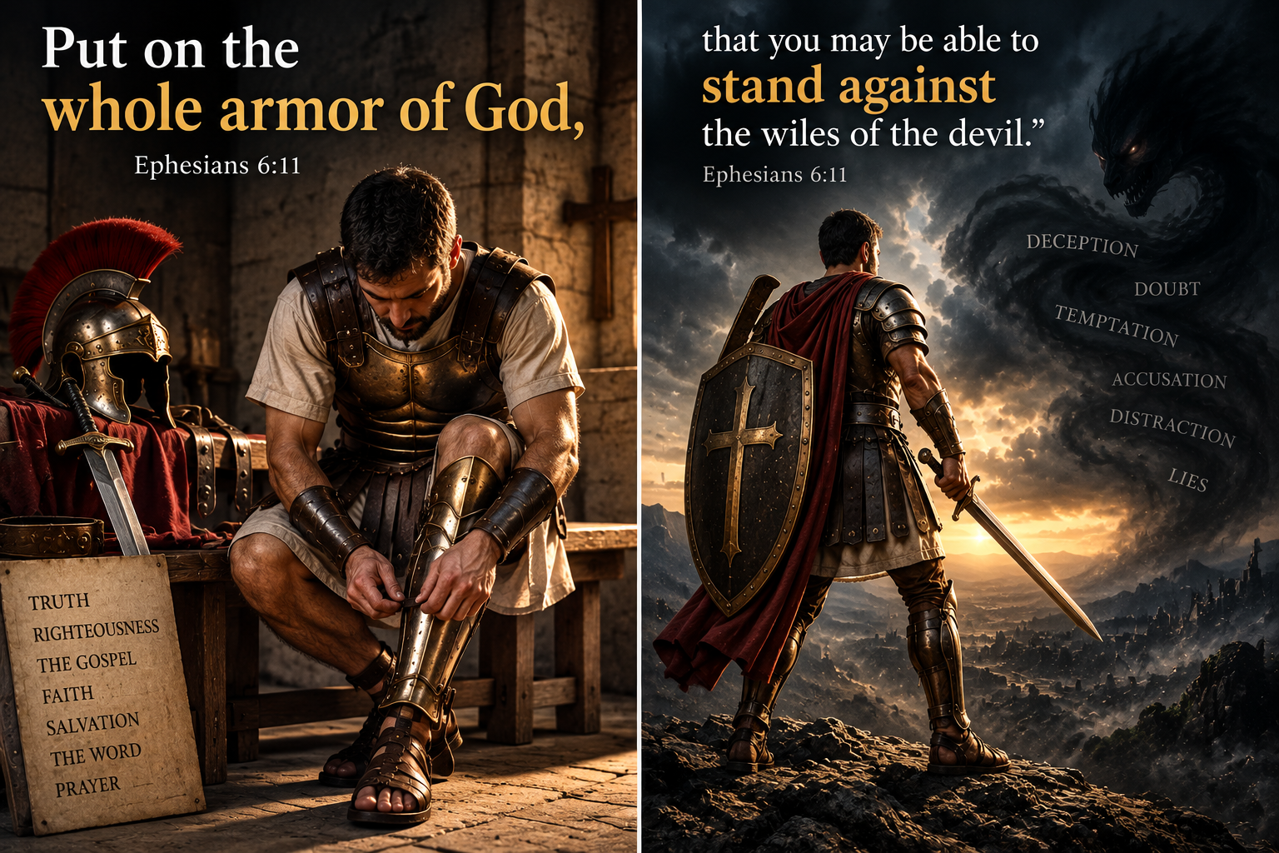
The Text: Ephesians 6:11
“Put on the whole armor of God, that you may be able to stand against the wiles of the devil.”
The Text

Slide 11
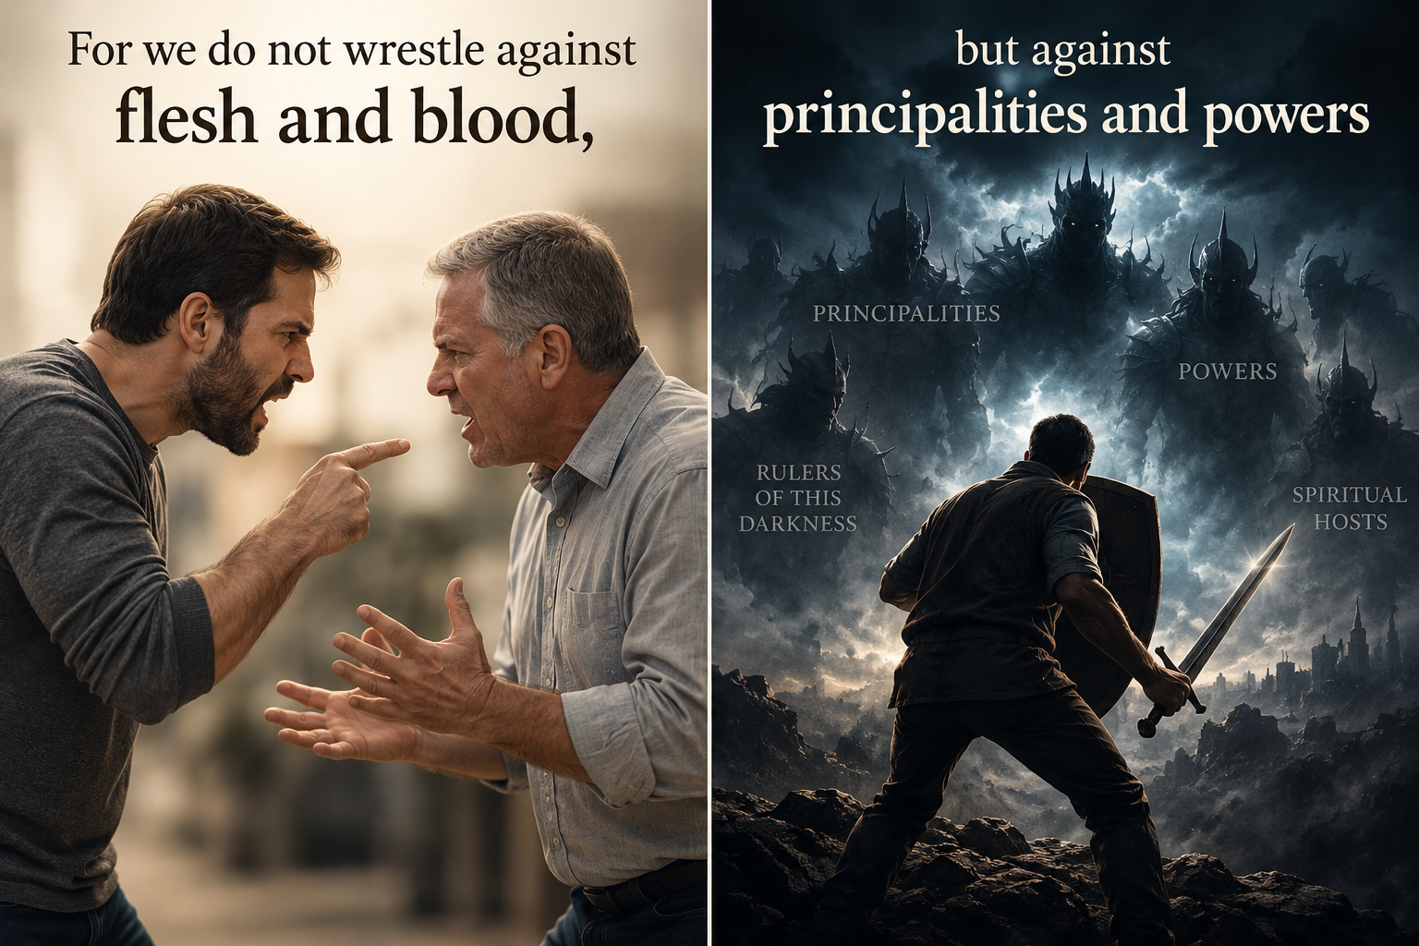
The Text: Ephesians 6:12
“For we do not wrestle against flesh and blood, but against principalities and powers, against the rulers of the darkness of this age, against spiritual hosts of wickedness in the heavenly places.”
The Text

Slide 12
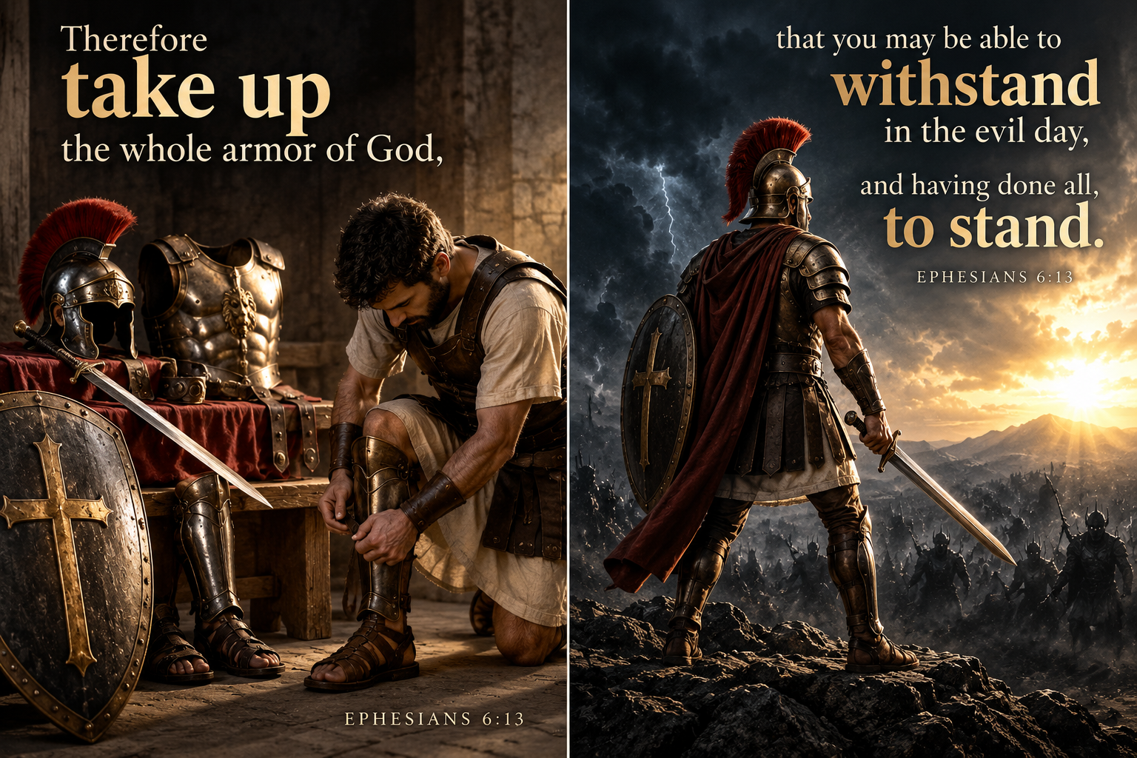
The Text: Ephesians 6:13
Therefore take up the whole armor of God, that you may be able to withstand in the evil day, and having done all, to stand.
The Text

Slide 13
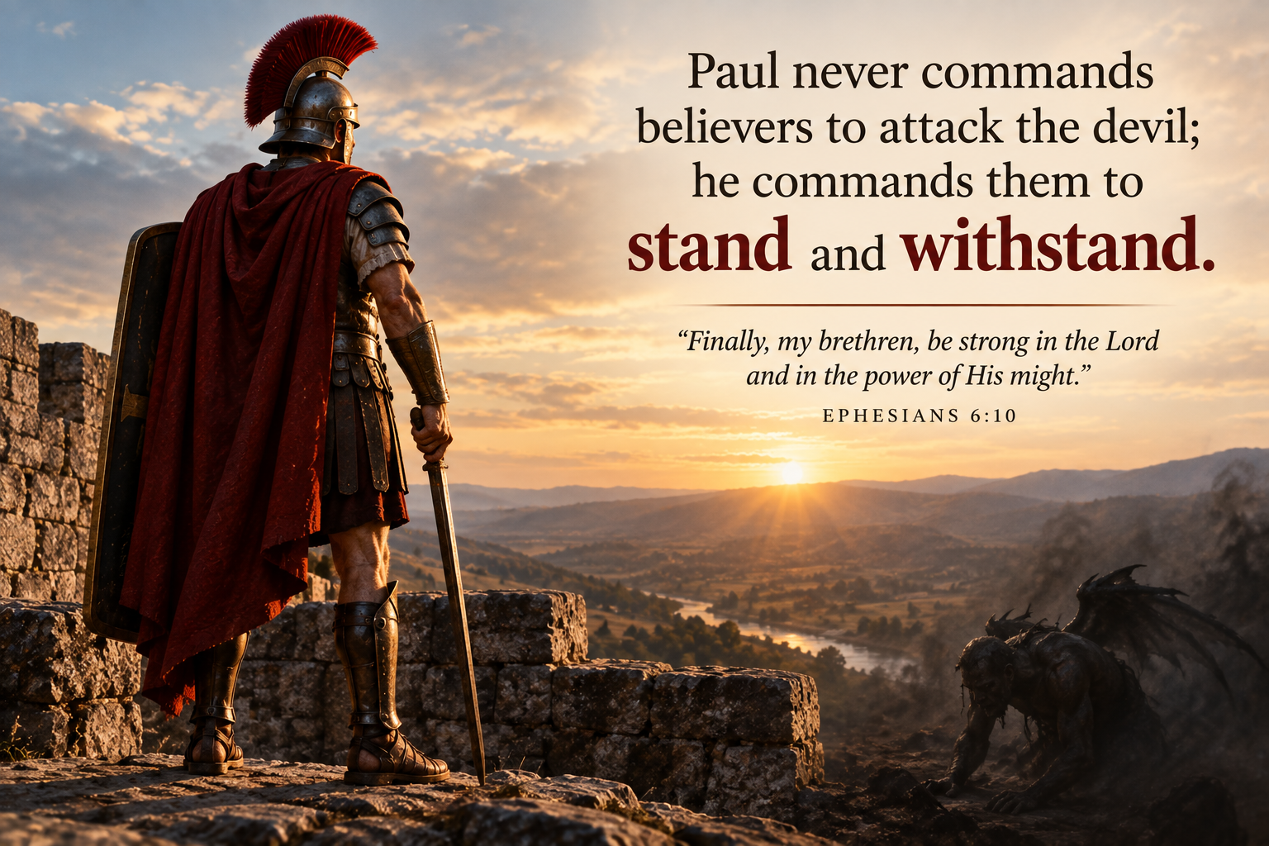
The Big Idea
Paul names what makes the Christian life a battle: a real, organized, spiritual enemy.
The passage opens and closes on the same command — stand.
  Eph 6:10-13 Finally, my brethren, be strong in the Lord and in the power of His might. 11 Put on the whole armor of God, that you may be able to stand against the wiles of the devil. 12 For we do not wrestle against flesh and blood, but against principalities, against powers, against the rulers of the darkness of this age, against spiritual hosts of wickedness in the heavenly places. 13 Therefore take up the whole armor of God, that you may be able to withstand in the evil day, and having done all, to stand.
The goal of spiritual warfare is not conquest but holding a position Christ has already secured.
Big Idea

Slide 14
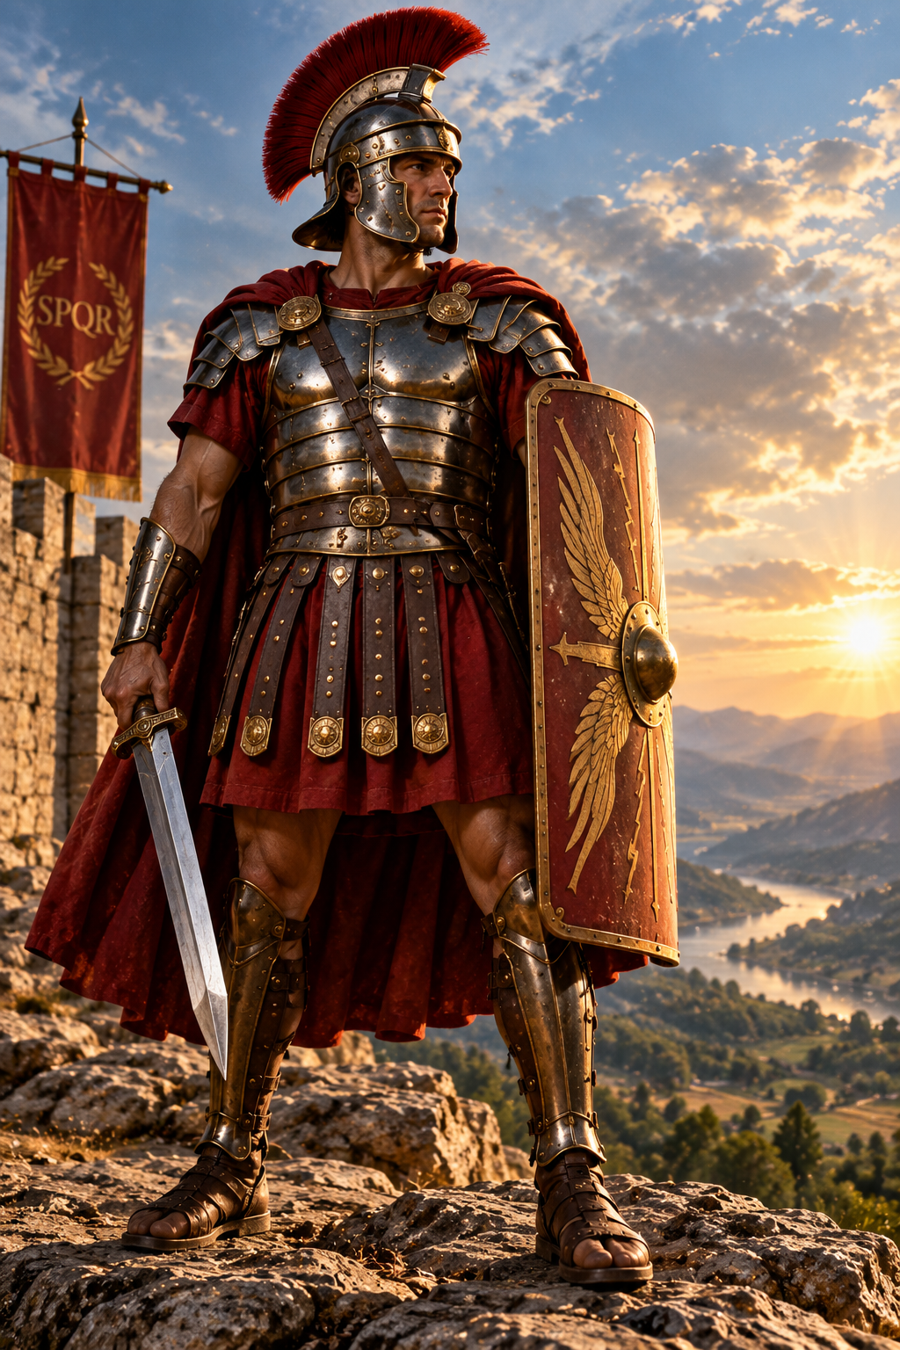
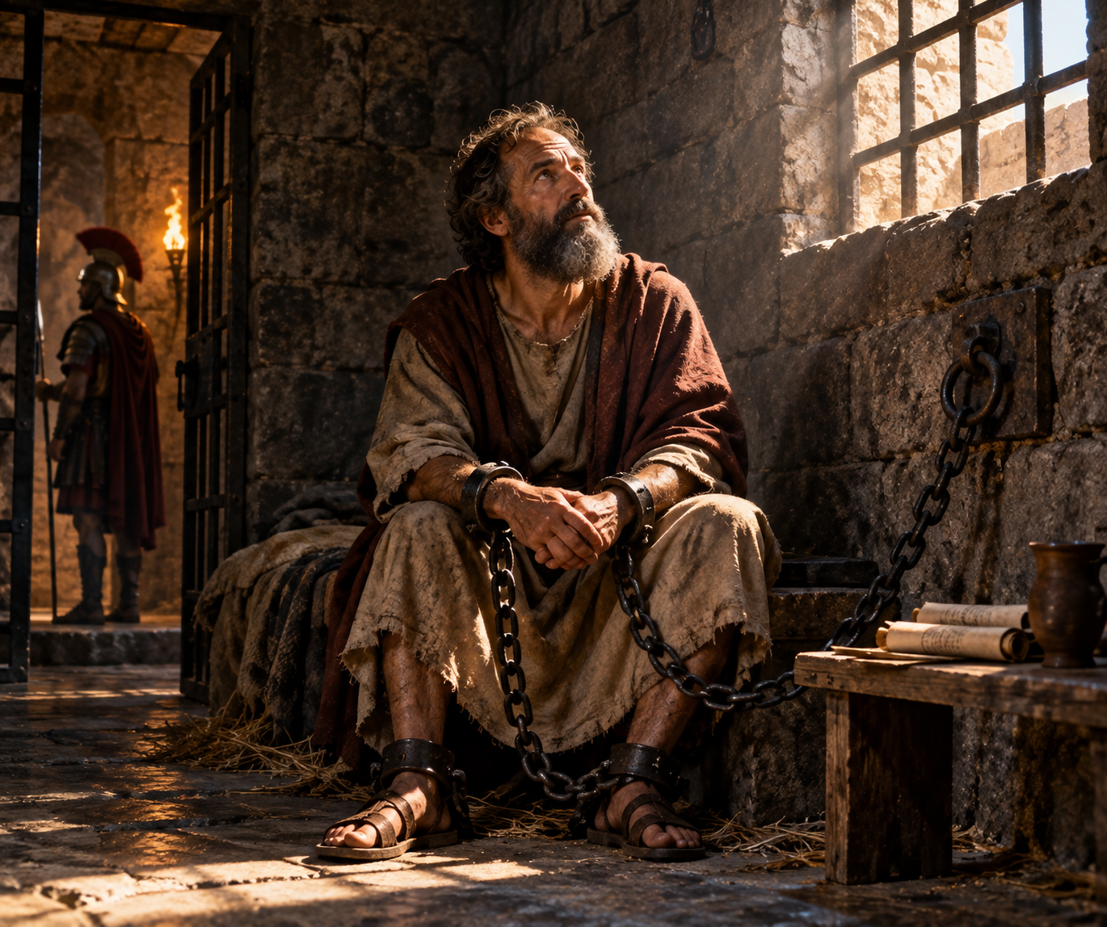
Literary and Historical Context
Ephesians 6:10–20 forms the letter’s closing charge.
Paul writes as “an ambassador in chains,” giving the armor image immediate force.
The imagery likely draws on both Roman soldiers and Isaiah’s portrait of the LORD as divine warrior.
Exegesis

Slide 15
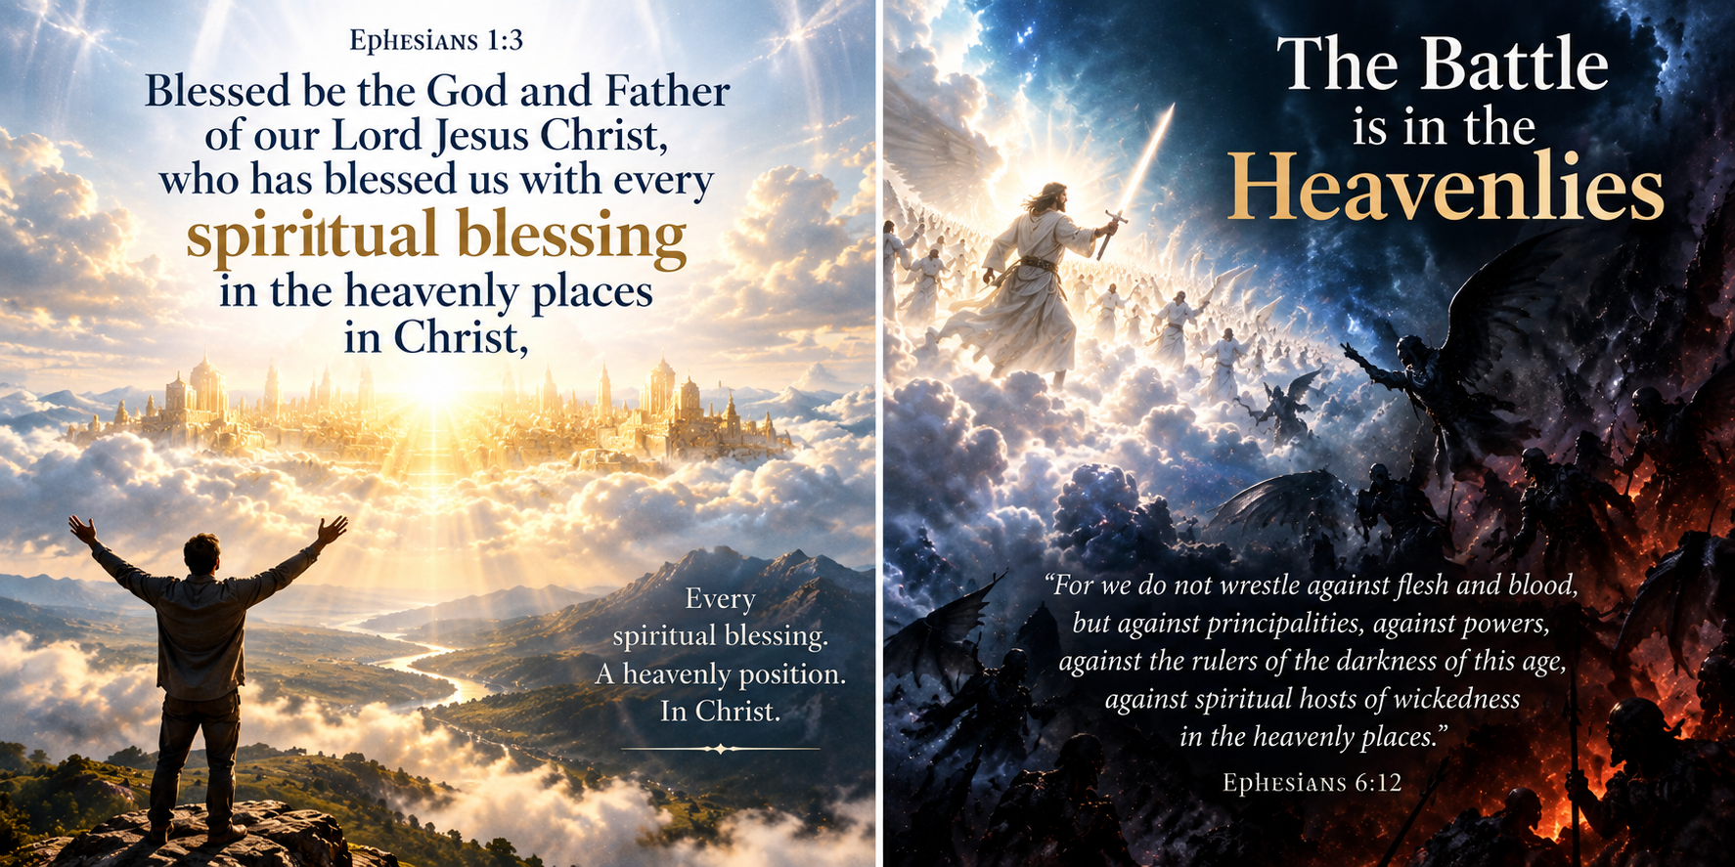
A Climax in the Letter
Ephesians opens with the believer’s blessing and position “in the heavenly places.”
  Eph 1:3 Blessed be the God and Father of our Lord Jesus Christ, who has blessed us with every spiritual blessing in the heavenly places in Christ,
Ephesians closes by naming the heavenly places as the realm of conflict.
  Eph 6:12 For we do not wrestle against flesh and blood, but against principalities, against powers, against the rulers of the darkness of this age, against spiritual hosts of wickedness in the heavenly places.

Slide 16
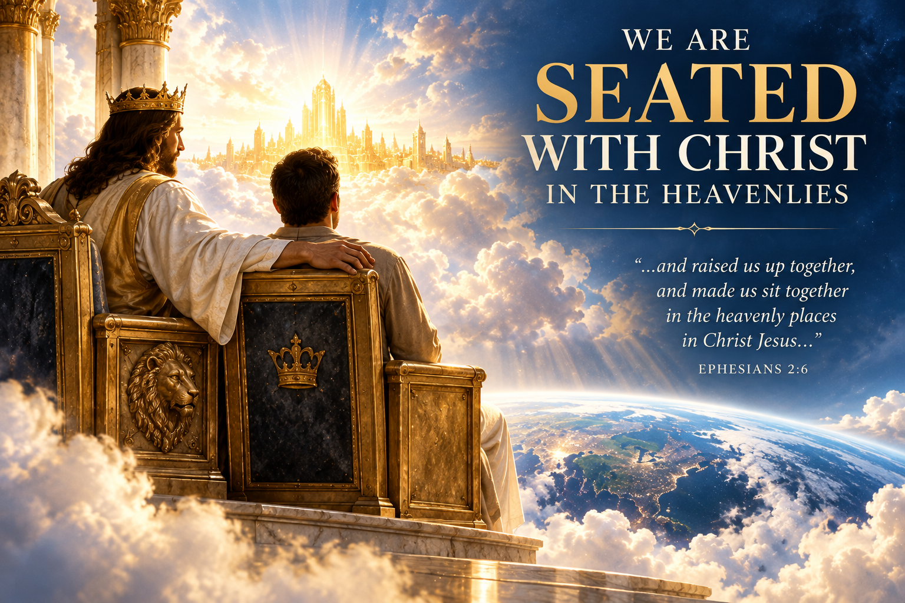
A Climax in the Letter
The same realm in which the believer is seated with Christ is also the arena where opposition is faced.
  Eph 2:6 and raised us up together, and made us sit together in the heavenly places in Christ Jesus,
The battle is real, but the believer’s position in Christ remains the governing reality.
  Union with Christ: Because believers are united with Jesus, what is true of Him is spiritually true of us. Since Christ is seated at God's right hand, believers share in His victory and standing before God.

Slide 17
The Standing Vocabulary
ἵστημι
stand / hold ground
ἀνθίστημι
stand against / resist
ἵστημι
stand therefore
Across verses 11, 13, and 14, the repeated emphasis is not advance or attack, but steady resistance from a fixed position.
Word Study

Slide 18
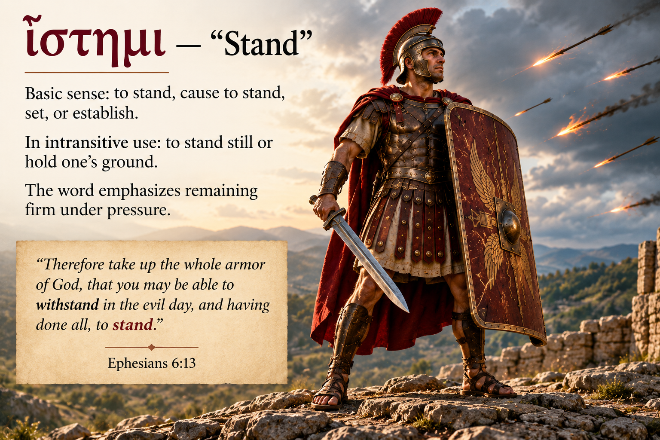
ἵστημι — “Stand”
Strong’s #G2476.
Basic sense: to stand, cause to stand, set, or establish.
In intransitive use: to stand still or hold one’s ground.
The word emphasizes remaining firm under pressure.
Word Study

Slide 19
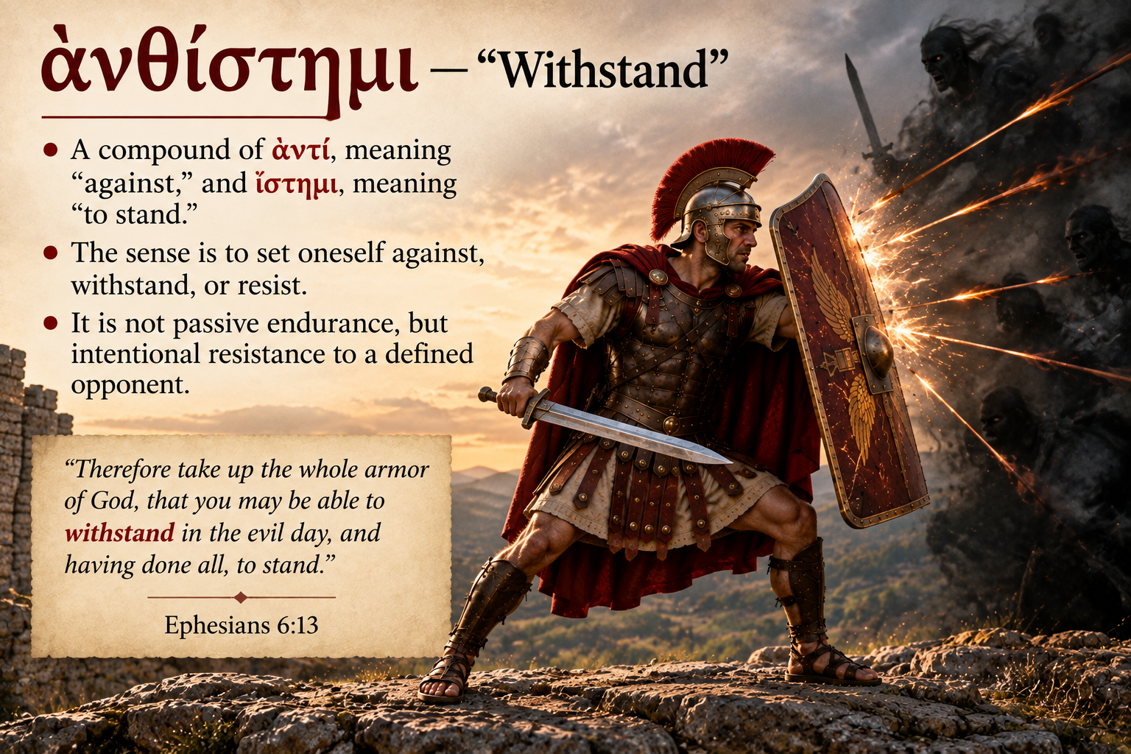
ἀνθίστημι — “Withstand”
Strong’s #G436.
A compound of ἀντί, meaning “against,” and ἵστημι, meaning “to stand.”
The sense is to set oneself against, withstand, or resist.
It is not passive endurance, but intentional resistance to a defined opponent.
Word Study

Slide 20
Structural Observations
Verse 11: standing is the goal of putting on the armor.
Verse 13: withstand and stand occur together, doubling the emphasis.
Verse 14: “Stand therefore” launches the itemized list of armor.
Across verses 11, 13, and 14, forms of ἵστημι or its compound appear repeatedly.
Word Study

Slide 21
Theology of Standing
Paul never commands believers to attack the devil; he commands them to stand and withstand.
The repeated vocabulary signals a defensive, not offensive, theology of spiritual conflict.
Courage in this passage looks like steadfastness more than aggression.
The believer holds ground already secured by Christ.
Application

Slide 22
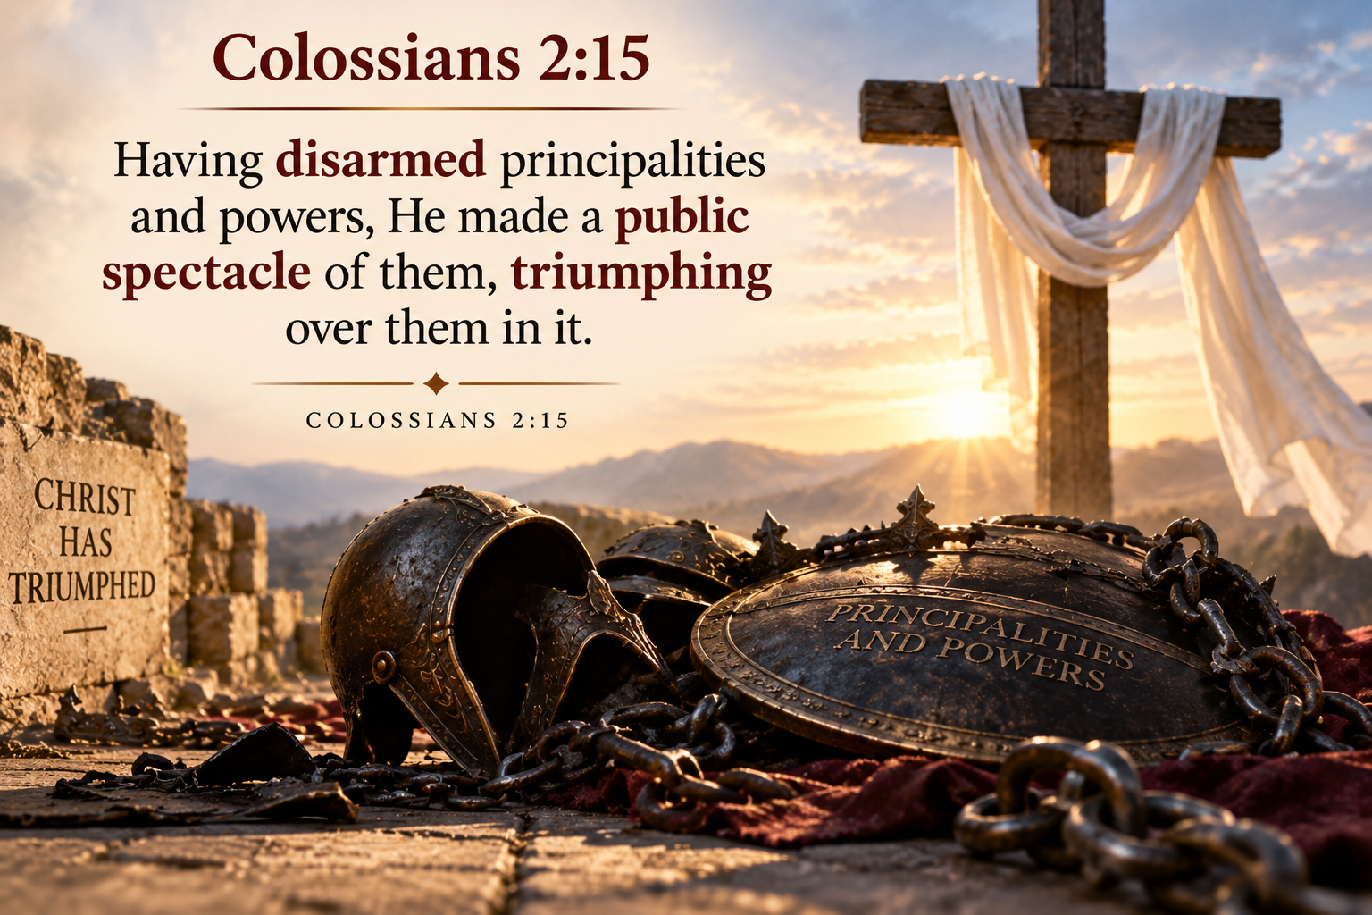
Victory Already Secured
Colossians 2:15 teaches that Christ has disarmed principalities and powers, made a public spectacle of them, and triumphed over them.
Ephesians 6 is therefore not a call to win the decisive battle, but to stand in the victory Christ has already won.
Application

Slide 23
Barnes on Strength
To be strong in the Lord means relying on Christ’s strength and promises.
The believer does not draw from a private reserve of spiritual strength.
Spiritual strength is received before it is exercised.
The appropriate posture is resolute holding, not anxious striving.
Application

Slide 24
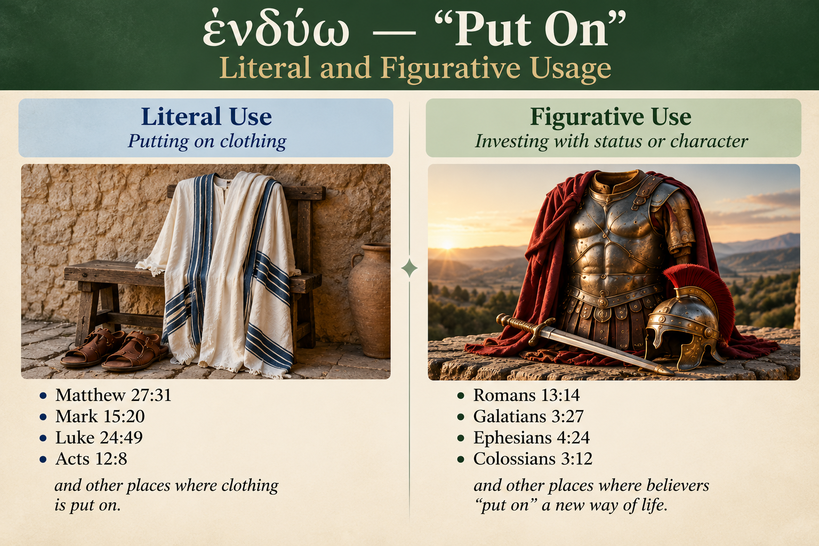
ἐνδύω — “Put On”
Strong’s #G1746.
Meaning: to put on, clothe, or invest with a garment.
Used both literally of clothing and figuratively of status or character.
In Ephesians 6:11 it is a decisive command : put on the whole armor of God.
Word Study

Slide 25
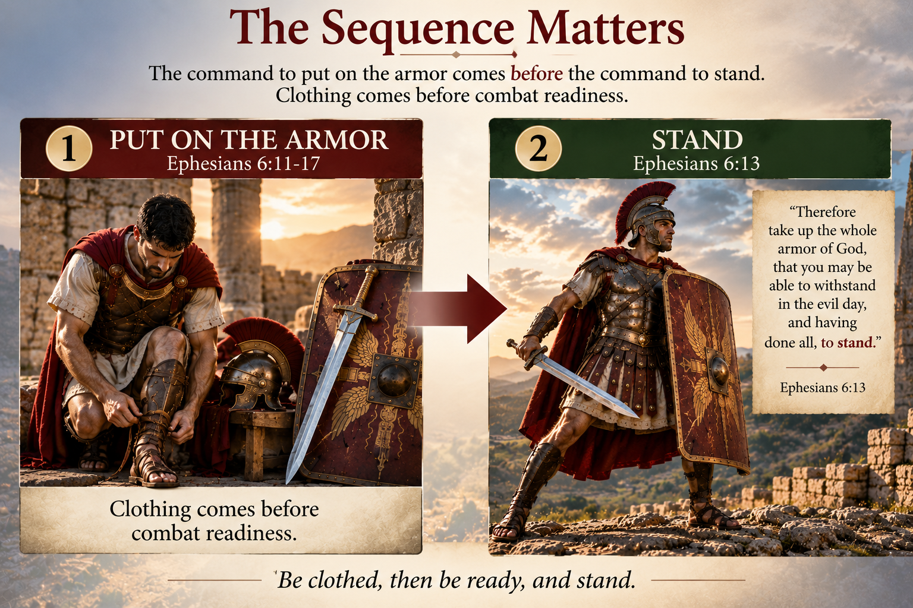
The Order Matters
The command to put on the armor comes before the command to stand.
Clothing comes before combat readiness.
Paul commands believers to put on the armor before he names any individual piece.
The whole life must be clothed before the specific items are examined.
Word Study

Slide 26
“Put On” Across Paul’s Letters
Romans 13:14
Galatians 3:27
Put on the Lord Jesus Christ
Baptized into Christ; put on Christ
Ephesians 4:22–24
Colossians 3:9–12
Put off the old man; put on the new man
Put on the new man and holy virtues
1 Thessalonians 5:8
Ephesians 6:11
Put on breastplate and helmet
Put on the whole armor of God
Word Study

Slide 27
Synthesis of ἐνδύω
It describes ongoing moral renewal as the new man.
  Rom. 13:10-14 Love does no harm to a neighbor; therefore love is the fulfillment of the law. 11 And do this, knowing the time, that now it is high time to awake out of sleep; for now our salvation is nearer than when we first believed. 12 The night is far spent, the day is at hand. Therefore let us cast off the works of darkness, and let us put on the armor of light. 13 Let us walk properly, as in the day, not in revelry and drunkenness, not in lewdness and lust, not in strife and envy. 14 But put on the Lord Jesus Christ, and make no provision for the flesh, to fulfill its lusts.
  Eph. 4:20-27 But you have not so learned Christ, 21 if indeed you have heard Him and have been taught by Him, as the truth is in Jesus: 22 that you put off, concerning your former conduct, the old man which grows corrupt according to the deceitful lusts, 23 and be renewed in the spirit of your mind, 24 and that you put on the new man which was created according to God, in true righteousness and holiness. 25 Therefore, putting away lying, "Let each one of you speak truth with his neighbor," for we are members of one another. 26 "Be angry, and do not sin": do not let the sun go down on your wrath, 27 nor give place to the devil.
Synthesis

Slide 28
Synthesis of ἐνδύω
It describes ongoing moral renewal as the new man.
  Col. 3:9-10 Do not lie to one another, since you have put off the old man with his deeds, 10 and have put on the new man who is renewed in knowledge according to the image of Him who created him,
  Eph. 6:10-11 Finally, my brethren, be strong in the Lord and in the power of His might. 11 Put on the whole armor of God, that you may be able to stand against the wiles of the devil.
It describes the cultivation of Christian virtues.
These are not separate metaphors, but one reality seen from different angles.
Synthesis

Slide 29
Three Images, One Continuous Reality
Conversion
Formation
Conflict
Put on Christ
Put on the new man
Put on the armor
The armor is not foreign equipment added to the believer; it is Christ-formed character deployed for battle.
Synthesis

Slide 30
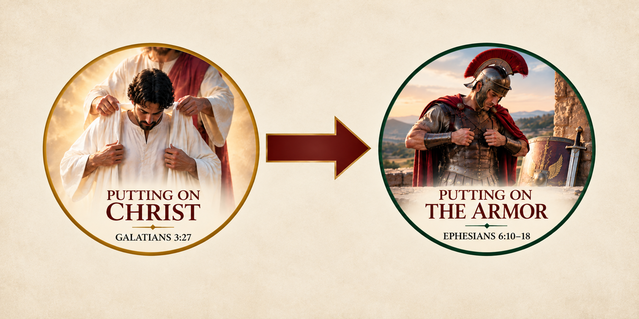
Significance for the Believer
The armor of God is not external to the believer’s character.
It is the believer’s Christ-formed character deployed for conflict.
There is no armor available that differs in kind from ordinary Christian growth.
Putting on the armor presupposes that the believer has already put on Christ.
Synthesis

Slide 31
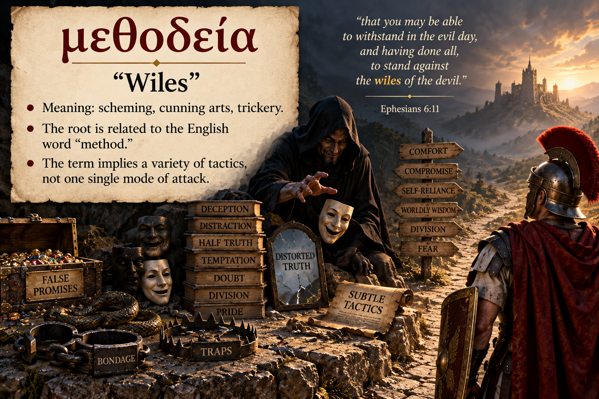
μεθοδεία — “Wiles”
Strong’s #G3180.
Meaning: scheming, cunning arts, trickery.
The root is related to the English word “method.”
The term implies a variety of tactics, not one single mode of attack.
Word Study

Slide 32
The Enemy’s Method
Barnes emphasizes that the devil works by stealth rather than open announcement.
The danger is often subtle deception, not obvious temptation.
The believer must be alert not only to attack, but to misdirection.
Truth counters deception because deception is methodical.
Application

Slide 33
The Nature of the Opposition
Verse 12 names four terms: principalities, powers, rulers of darkness, and spiritual hosts of wickedness.
The opposition is spiritual, organized, and real.
Scripture gives enough detail to make believers sober, but not enough to construct a complete hierarchy.
The focus remains on standing in God’s provision, not speculating about the enemy.
Verse 12

Slide 34
Not Flesh and Blood
Paul does not deny human conflict; he redefines what is underneath it.
The believer must not treat people as the ultimate enemy.
Remembering this changes how we respond to those who hurt, resist, or oppose us.
The battle requires weapons suited to spiritual reality.
Verse 12

Slide 35
Heavenly Places
The phrase “in the heavenly places” echoes earlier uses in Ephesians.
Believers are blessed in Christ in the heavenly places.
Christ is seated above all rule and authority.
Believers are seated with Him, yet also warned that the heavenly places are a realm of conflict.
The conflict occurs where Christ already reigns.
Verse 12

Slide 36
Discussion Questions
1
Why does Paul ground the armor of God in being strong “in the Lord” rather than personal willpower?
2
Where have you seen subtle deception be a greater danger than obvious temptation?
3
Where might God be calling you to hold your ground rather than chase a dramatic breakthrough?
4
How does remembering that we do not wrestle against flesh and blood change your response to opposition?
5
What difference does it make to know the opposition is organized and real?
Questions

Slide 37
Analysis Questions
1
What does the repeated stand language in verses 11, 13, and 14 suggest about Paul’s emphasis?
2
Why command believers to put on the armor before describing each piece?
3
How do you account for the shift from wrestling imagery to soldier imagery?
4
What does Paul’s use of “put on” for Christ, the new man, and armor suggest?
5
Do the four terms in verse 12 name distinct categories or accumulate emphasis?
Questions

Slide 38
Personal Evaluation Question
Which verb names the area where you most need to grow: stand or put on?
Do you most need to stand firm under pressure you already face?
Or do you need to put on more deliberately the character that readiness for battle requires?
Be specific about what that growth would look like this week.
Personal Response

Slide 39
Worldview-Impact Question
Before this study began, how would you have described spiritual warfare?
How does knowing that the outcome rests in Christ’s finished victory change how you face conflict?
What will it mean this week to face conflict without panic and without presumption?
Where can you practice steady, humble resistance?
Personal Response

Slide 40
End-of-Class Summary
This week we saw that Paul frames the Christian life as a real battle — but one where the outcome is already settled in Christ.
The repeated command to stand shows that our part is not conquest, but the resolute holding of ground Christ has already won.
The command to put on shows how: by living out, deliberately and for battle, the same new man we already put on in Christ.
Summary

Slide 41
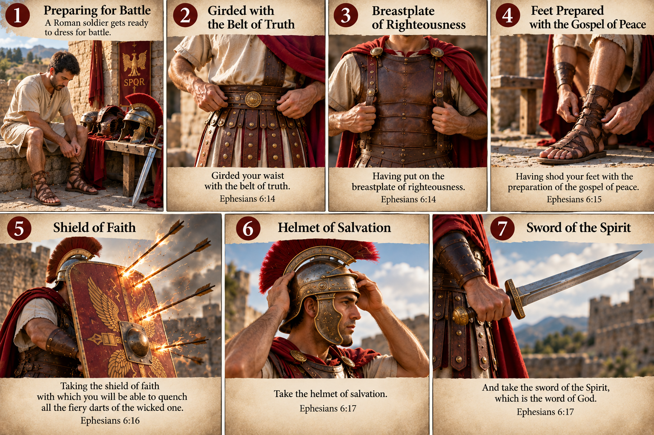
End-of-Class Summary
Summary

